Slide 1
BECOME SQL CHAMPION
BY HARSHIT BHADIYADRA
11 + years of experience and WORKED IN – CAPGEMINI, MINDTREE, GLOBANT, KASEYA SOFTWARE

Slide 2
SECTION – 1 BEGINNER LEVEL SQL CHAMPION
Section 1:BEGINNER LEVEL SQL CHAMPION
Lecture 1:INTRODUCTION - COURSE CONTENT
Lecture 2:BASICS OF DATABASES
Lecture 3:DATABASE FURTHER EXPLAINED
Lecture 4:SQL CONSTRAINTS IN DETAILS
Lecture 5:SQL OPERATORS PART -1
Lecture 6:SQL OPERATORS PART -2
Lecture 7:NORMALIZATION IN RDBMS EXPAINED PRACTICALLY
Lecture 8:ANOMALIES IN NORMALIZATION AND SQL OPERATORS
Lecture 9:LIKE , IS NULL, IS NOT NULL, ORDER BY , DISTINCT
Lecture 10:DML - UPDATE STATEMENTS AND CASE STATEMENTS
Lecture 11:DELETE , DROP AND TRUNCATE STATEMENTS IN SQL
Lecture 12:ON DELETE CASCADE_SET_NULL AND SET DEFAULT

Slide 3
SECTION – 2 INTERMEDIATE LEVEL SQL CHAMPION
Section 2:INTERMEDIATE LEVEL SQL CHAMPION
Lecture 13:DATE-DATETIME FUNCTIONS_PART_1
Lecture 14:DATE FUNCTIONS PART- 2 AND STRING FUNCTIONS PART - 1
Lecture 15:STRING FUNCTIONS PART-2
Lecture 16:MATHEMATICAL FUNCTIONS AND CONVERSION FUNCTIONS
Lecture 17:SPECIAL FUNCTIONS AND AGGREGATE FUNCTIONS
Lecture 18:GROUP BY AND HAVING AND ROLLUP AND CUBE

Slide 4
SECTION – 3 ADVANCED LEVEL SQL CHAMPION
Section 3:ADVANCED LEVEL SQL CHAMPION
Lecture 19:WINDOWS RANKING FUNCTIONS
Lecture 20:WINDOWS AGGREGATE FUNCTIONS
Lecture 21:WINDOWS ANALYTIC FUNCTIONS
Lecture 22:SQL JOINS PART -1
Lecture 23:SELF JOIN AND NON-EQUI JOIN
Lecture 24:SET OPERATORS AND DERIVED TABLES
Lecture 25:SUBQUERY AND CORELATED SUBQUERY
Lecture 26:SUBQUERIES AND EXISTS , NOT-EXISTS OPERATOR
Lecture 27:COMMON TABLE EXPRESSIONS AND RECURSIVE CTES
Lecture 28:RECURSIVE CTES AND TEMPORARY TABLES
Lecture 29:SQL VIEWS
Lecture 30:INLINE TABLE VALUED FUNCTIONS_SYNONYMS_AND_SEQUENCES
Lecture 31:INDEXES IN SQL
Lecture 32:MERGE STATEMENT AND PIVOT AND UNPIVOT

Slide 5
SECTION – 4 TRANSACT - SQL
Section 4:TRANSACT - SQL
Lecture 33:T-SQL VARIABLES
Lecture 34:CONDITIONAL STATEMENTS
Lecture 35:LOOPING CONSTRUCT
Lecture 36:CURSORS IN SQL
Lecture 37:EXCEPTION HANDLING
Lecture 38:STORED PROCEDURES PART - 1
Lecture 39:STORED PROCEDURES PART - 2
Lecture 40:TABLE VARIABLES & STORED FUNCTIONS
Lecture 41:COMMON DATABASE RETRIEVAL INFORMATION QUERIES
Lecture 42:DYNAMIC SQL

Slide 6

SECTION – 5 SOLVE FAANG & MAANG SQL PROBLEMS

Slide 7
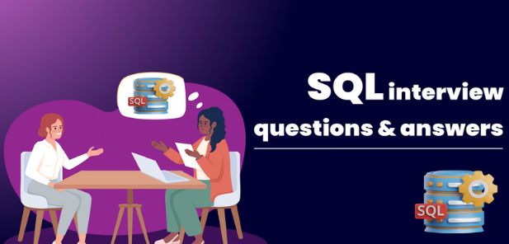
SECTION – 6 BE INTERVIEW READY IN SQL

Slide 8

SECTION – 7 REAL TIME PROJECTS IN SQL

Slide 9

SECTION – 8 SQL USING AI
Solve SQL Queries using AI

