Slide 1
The Secret Life of Hello World
pwn.college Fundamentals Series
Yan Shoshitaishvili
Arizona State University

Slide 2
Computer Science is built on abstraction
You've seen this:
# ./helloworld
Hello world!
But what happens under the hood?

Slide 3
The Command Line

Slide 4
Linux is fun
# ./helloworld
Wat?

Slide 5
Programming Languages

Slide 6
C: Hello World

Slide 7
C: Types

Slide 8
C: I/O

Slide 9
C: Structs

Slide 10
C: Memory

Slide 11
C: Pointers

Slide 12
C: Data

Slide 13
Decimal, Hexadecimal, and Binary

Slide 14
ASCII

Slide 15
C: Function Pointers

Slide 16
C: Libraries

Slide 17
C: Constructors and Destructors

Slide 18
Initialization
Programs can specify constructors, which are functions that run before the program is actually launched.
For example, depending on the version, libc can initialize memory regions for dynamic allocations (malloc/free) when the program launches.
You can specify your own!
__attribute__((constructor)) void haha()
{
puts("Hello world!");
}
Demo: LD_PRELOAD and constructors.

Slide 19
Termination
Similarly, you can specify destructors that run after the program is done.
__attribute__((destructor)) void haha()
{
puts("Hello world!");
}

Slide 20
C: The Compilation Process

Slide 21
C: Cross-Compiling

Slide 22
ELF: The Hello World Binary

Slide 23
What is cat?
yans@cse466 ~ $ file helloworld
helloworld: ELF 64-bit LSB shared object, x86-64, version 1 (SYSV), dynamically linked, interpreter /lib64/ld-linux-x86-64.so.2, for GNU/Linux 3.2.0, BuildID[sha1]=747e524bc20d33ce25ed4aea108e3025e5c3b78f, stripped

Slide 24

What is an ELF?
ELF is a binary file format.
Contains the program and its data.
Describes how the program should be loaded (program/segment headers).
Contains metadata describing program components (section headers).

Slide 25
ELF: Segments

Slide 26
ELF Program Headers
Program headers specify information needed to prepare the program for execution. Most important entry types:
INTERP: defines the library that should be used to load this ELF into memory.
LOAD: defines a part of the file that should be loaded into memory.
Program headers are the source of information used when loading a file.

Slide 27
ELF: Sections

Slide 28
ELF Section Headers
A different view of the ELF with useful information for introspection, debugging, etc.
Important sections:
.text: the executable code of your program.
.plt and .got: used to resolve and dispatch library calls.
.data: used for pre-initialized global writable data (such as global arrays with initial values)
.rodata: used for global read-only data (such as string constants)
.bss: used for uninitialized global writable data (such as global arrays without initial values)
Section headers are not a necessary part of the ELF: only segments (defined via program headers) are needed for loading and operation! Section headers are just metadata.

Slide 29
ELF: Symbols

Slide 30
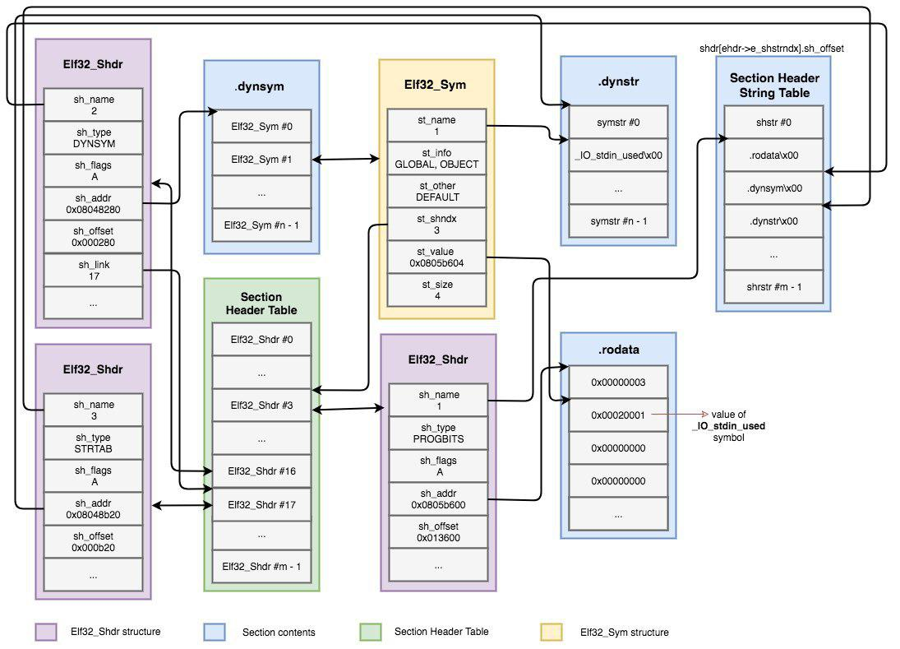
Symbols
Binaries (and libraries) that use dynamically loaded libraries rely symbols (names) to find libraries, resolve function calls into those libraries, etc.
Source (and further reading): https://www.intezer.com/blog/elf/executable-linkable-format-101-part-2-symbols/

Slide 31
ELF: Static vs Dynamic

Slide 32
TODO
TODO

Slide 33
ELF: Tools

Slide 34
Interacting with your ELF
Several ways to dig in:
gcc to make your ELF.
readelf to parse the ELF header.
objdump to parse the ELF header and disassemble the source code.
nm to view your ELF's symbols.
patchelf to change some ELF properties.
objcopy to swap out ELF sections.
strip to remove otherwise-helpful information (such as symbols).
kaitai struct (https://ide.kaitai.io/) to look through your ELF interactively.
cle (https://github.com/angr/cle) to play around with your ELF!
Further reading:
https://www.intezer.com/blog/research/executable-linkable-format-101-part1-sections-segments/
https://www.intezer.com/blog/elf/executable-linkable-format-101-part-2-symbols/
https://www.intezer.com/blog/elf/executable-and-linkable-format-101-part-3-relocations/
https://www.intezer.com/blog/elf/executable-linkable-format-101-part-4-dynamic-linking/ \

Slide 35
Assembly: The Ghost in Hello World

Slide 36
TODO
TODO

Slide 37
Assembly: Computer Architecture

Slide 38
All roads lead to the CPU
Source Code
Python, JavaScript, Java
C, C++, Rust
Intermediate Language Bytecode
Interpreter or JIT
Compiler
Binary-encoded Instructions
CPU

Slide 39








Digging Deeper
http://www.electronics-tutorials.ws/logic/logic_1.html

Slide 40
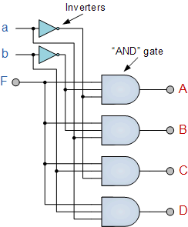
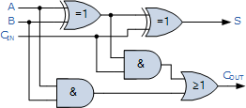
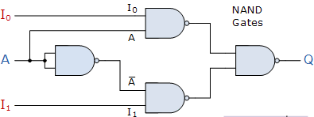
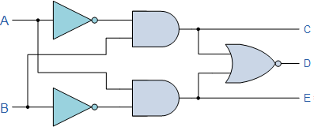
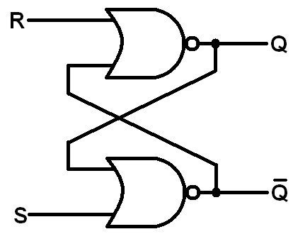
Too deep!
http://www.electronics-tutorials.ws/category/combination

Slide 41
Computer Architecture (very high level)
Memory
CPU
Disk
"Some sort of bridge."
Network + Others

Slide 42
Computer Architecture (drilling down)
Memory
CPU
Disk
Registers
CU
"Some sort of bridge."
ALU
Network + Others

Slide 43
Computer Architecture (further down!)
Memory
CPU
Disk
Registers
CU
"Some sort of bridge."
Cache
ALU
Network + Others

Slide 44
Computer Architecture (as far as we'll go)
CPU
Memory
L2
Cache
Registers
CU
Disk
L1 Cache
ALU
"Some sort of bridge."
Registers
CU
Network + Others
L1 Cache
ALU

Slide 45
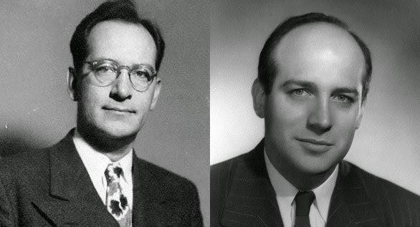
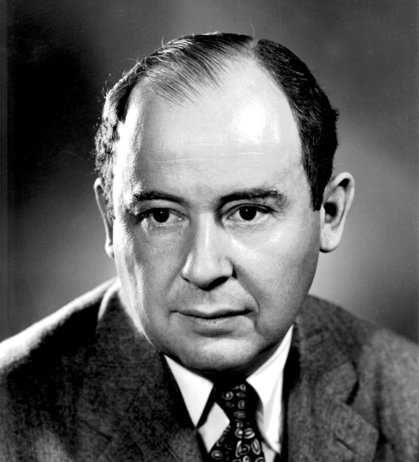
John Mauchly (Physicist), John Presper Eckert (Electrical Engineer), John Von Neumann (Mathematician)
John von Neumann, First Draft of a Report on the EDVAC, 1945.

Slide 46
Assembly: Overview

Slide 47
Assembly
The only true programming language, as far as a CPU is concerned.
Concepts:
instructions
  data manipulation instructions
  comparison instructions
  control flow instructions
  system calls
registers
memory
  program
  stack
  other mapped mem

Slide 48
Assembly: Registers

Slide 49
Registers
Registers are very fast, temporary stores for data.
You get several "general purpose" registers:
8085: a, c, d, b, e, h, l
8086: ax, cx, dx, bx, sp, bp, si, di
x86: eax, ecx, edx, ebx, esp, ebp, esi, edi
amd64: rax, rcx, rdx, rbx, rsp, rbp, rsi, rdi, r8, r9, r10, r11, r12, r13, r14, r15
arm: r0, r1, r2, r3, r4, r5, r6, r7, r8, r9, r10, r11, r12, r13, r14
The address of the next instruction is in a register:
eip (x86), rip (amd64), r15 (arm)
Various extensions add other registers (x87, MMX, SSE, etc).

Slide 50
Partial Register Access
rax
eax
ax
ah
al
Registers can be accessed partially.
Due to a historical oddity, accessing eax will zero out the rest of rax. Other partial access preserve untouched parts of the register.

Slide 51
All partial accesses on amd64 (that I know of)
64 32 16 8H 8L
rax eax ax ah al
rcx ecx cx ch cl
rdx edx dx dh dl
rbx ebx bx bh bl
rsp esp sp spl
rbp ebp bp bpl
rsi esi si sil
rdi edi di dil
r8 r8d r8w r8b
r9 r9d r9w r9b
r10 r10d r10w r10b
r11 r11d r11w r11b
r12 r12d r12w r12b
r13 r13d r13w r13b
r14 r14d r14w r14b
r15 r15d r15w r15b

Slide 52
Assembly: Memory

Slide 53
Memory (stack)
The stack fulfils four main uses:
Track the "callstack" of a program.
  return values are "pushed" to the stack during a call and "popped" during a ret
Contain local variables of functions.
Provide scratch space (to alleviate register exhaustion).
Pass function arguments (always on x86, only for
functions with "many" arguments on other architectures).
Relevant registers (amd64): rsp, rbp
Relevant instructions (amd64): push, pop

Slide 54
Memory (other mapped regions)
Other regions might be mapped in memory. We previously talked about regions loaded due to directives in the ELF headers, but functionality such as mmap and malloc can cause other regions to be mapped as well.
These will feature prominently (and be discussed) in future modules.

Slide 55
Assembly: Instructions

Slide 56
Instructions
General form:
PREFIX OPCODE OPERAND OPERAND, ...
PREFIX - modification of the instruction
OPCODE - what to do
OPERANDS - what to do it on/with
PREFIX - modifier for the instruction
mov rax, rbx
add rax, 1
cmp rax, rbx
jb some_location
Useful reference: http://ref.x86asm.net

Slide 57
Instructions (data transfer)
Instructions can move and manipulate data in registers and memory.
mov rax, rbx
push rbx
pop rax

Slide 58
Instructions (data manipulation)
Instructions can move and manipulate data in registers and memory.
mov rax, rbx
mov rax, [rbx+4]
add rax, rbx
mul rsi
inc rax
inc [rax]

Slide 59
Instructions (control flow)
Control flow is determined by conditional and unconditional jumps.
Unconditional: call, jmp, ret
Conditional:
je jne jg jl jle jge ja jb jae jbe js jns jo jno jz jnz | jump if equal jump if not equal jump if greater jump if less jump if less than or equal jump if greater than or equal jump if above (unsigned) jump if below (unsigned) jump if above or equal (unsigned) jump if below or equal (unsigned) jump if signed jump if not signed jump if overflow jump if not overflow jump if zero jump if not zero
cmp rax, rbx
jb some_location 🤔

Slide 60
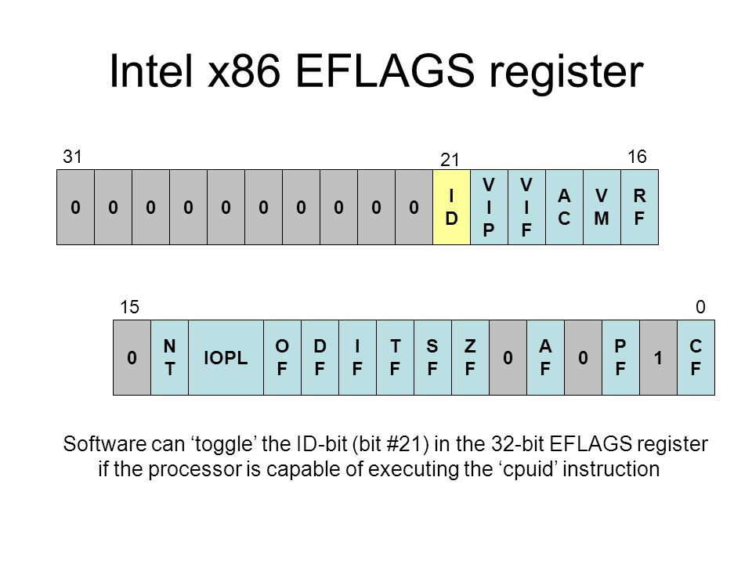
Instructions (conditionals)
je jne jg jl jle jge ja jb jae jbe js jns jo jno jz jnz | jump if equal jump if not equal jump if greater jump if less jump if less than or equal jump if greater than or equal jump if above (unsigned) jump if below (unsigned) jump if above or equal (unsigned) jump if below or equal (unsigned) jump if signed jump if not signed jump if overflow jump if not overflow jump if zero jump if not zero | ZF=1 ZF=0 ZF=0 and SF=OF SF!=OF ZF=1 or SF!=OF SF=OF CF=0 and ZF=0 CF=1 CF=0 CF=1 or ZF=1 SF=1 SF=0 OF=1 OF=0 ZF=1 ZF=0
Conditionals key off of the "flags" register:
eflags (x86), rflags (amd64), aspr (arm).
Updated by (x86/amd64):
arithmetic operations
cmp - subtraction (cmp rax, rbx)
test - and (test rax, rax)

Slide 61
Conventions
Two syntax conventions for x86 assembly:
The right one: Intel Syntax
The wrong one: AT&T Syntax
We (along with all reasonable hackers) will be using Intel syntax.
Unfortunately, gcc uses AT&T syntax by default. We have to run it with:
to assemble: gcc -masm=intel
disassemble: objdump -M intel

Slide 62
Assembly: System Calls

Slide 63
Instructions (system calls)
Almost all programs have to interact with the outside world!
This is primarily done via system calls (man syscalls). Each system call is well-documented in section 2 of the man pages (i.e., man 2 open).
System calls (on amd64) are triggered by:
set rax to the system call number
store arguments in rdi, rsi, etc (more on this later)
call the syscall instruction
We can trace process system calls using strace.

Slide 64
System Calls
System calls have very well-defined interfaces that very rarely change.
There are over 300 system calls in Linux. Here are some examples:
int open(const char *pathname, int flags) - returns a file new file descriptor of the open file (also shows up in /proc/self/fd!)
ssize_t read(int fd, void *buf, size_t count) - reads data from the file descriptor
ssize_t write(int fd, void *buf, size_t count) - writes data to the file descriptor
pid_t fork() - forks off an identical child process. Returns 0 if you're the child and the PID of the child if you're the parent.
int execve(const char *filename, char **argv, char **envp) - replaces your process.
pid_t wait(int *wstatus) - wait child termination, return its PID, write its status into *wstatus.
Typical signal combinations:
fork, execve, wait (think: a shell)
open, read, write (cat)
Critical resource: https://blog.rchapman.org/posts/Linux_System_Call_Table_for_x86_64/

Slide 65
Assembly: Data Formats

Slide 66
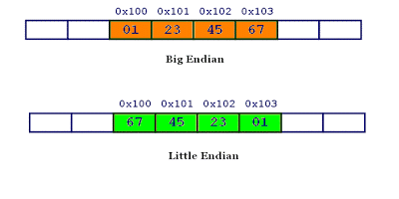
Memory (endianess)
Data on most modern systems is stored backwards, in little endian.
Why?
Performance (historical)
Ease of addressing for different sizes.
(apocryphal) 8086 compatibility

Slide 67
Signedness: Two's Compliment
How to differentiate between positive and negative numbers?
One idea: signed bit (8-bit example):
b00000011 == 3
b10000011 == -3
drawback 1: b00000000 == 0 == b10000000
drawback 2: arithmetic operations have to be signedness-aware
(unsigned) b11111111 + 1 == 255 + 1 == 0 == b00000000
(signed) b11111111 + 1 == -127 + 1 == -126 == b11111110
Clever (but crazy) approach: two's complement
b00000000 == 0
0 - 1 == b11111111 == 0xff == -1
-1 - 1 == b11111110 == 0xfe == -2
advantage: arithmetic operations don't have to be sign-aware!
(unsigned) b11111111 + 1 == 255 + 1 == 0 == b00000000
(signed) b11111111 + 1 == -1 + 1 == 0 == b00000000
disadvantage: you might go crazy
As a benefit of two's complement, signedness mostly crops up in conditional checks.

Slide 68
Assembly: Calling Conventions

Slide 69
Calling Conventions
Callee and caller functions must agree on argument passing.
Linux x86: push arguments (in reverse order), then call (which pushes return address), return value in eax
Linux amd64: rdi, rsi, rdx, rcx, r8, r9, return value in rax
Linux arm: r0, r1, r2, r3, return value in r0
Registers area limited and shared resource, so calling conventions should agree on what registers are protected.
Linux amd64: rbx, rbp, r12, r13, r14, r15 are "callee-saved"

Slide 70
Assembly: History of x86

Slide 71
The long road behind us...
Intel 8085 (1976)
8-bit processor
registers: a, c, d, b, e, h, l
Intel 8086 (1978):
16-bit processor
registers: ax, cx, dx, bx, sp, bp, si, di
Intel 80386:
32-bit processor
eax, ecx, edx, ebx, esp, ebp, esi, edi
AMD64:
64-bit processor
registers: rax, rcx, rdx, rbx, rsp, rbp, rsi, rdi, r8, r9, r10, r11, r12, r13, r14, r15

Slide 72
All partial accesses on amd64 (that I know of)
64 32 16 8H 8L
rax eax ax ah al
rcx ecx cx ch cl
rdx edx dx dh dl
rbx ebx bx bh bl
rsp esp sp spl
rbp ebp bp bpl
rsi esi si sil
rdi edi di dil
r8 r8d r8w r8b
r9 r9d r9w r9b
r10 r10d r10w r10b
r11 r11d r11w r11b
r12 r12d r12w r12b
r13 r13d r13w r13b
r14 r14d r14w r14b
r15 r15d r15w r15b

Slide 73
Backwards Compatibility
Backwards compatibility reduces adoption barriers.
x86 can switch to 16-bit mode.
amd64 can switch to 32-bit mode and to 16-bit mode.
Most instructions on amd64, even in 64-bit mode, still operate on 32-bit data by default!
To make them 64-bit, the REX prefix is used.
Notable exceptions: push, pop

Slide 74
Assembly: Writing Programs!

Slide 75
hello_world.s
Recall the compilation process:
C → Assembly → Binary
You don't have to start at C, but it's useful for learning!
gcc -S -masm=intel -o helloworld.s helloworld.c
gcc -o helloworld helloworld.s

Slide 76
Assembly from Scratch
Write your program as assembly:
.intel_syntax noprefix # use the correct assembly format!
.section .rodata # defines the read only data section
.hello: # a label to reference the following data
.string "Hello!" # the data representing the "Hello!" string
.section .text # defines the section containing the code
.global main # main needs to be globally accessible outside of just this file
main: # a label for the main function
lea rdi, [rip+.hello] # load the address of "Hello!"
call puts # print out the string!
mov rdi, 42 # first argument to exit
call exit # exit cleanly!
Then, assemble it!
gcc -nostdlib -static helloworld.s -o helloworld

Slide 77
Tangent: DATA in your CODE
.string "/bin/sh" ???
Many ways to add data:
.byte 0x48, 0x45, 0x4C, 0x4C, 0x4F # "HELLO"
.string "HELLO" # "HELLO\0"
Many others! Full list: http://web.mit.edu/gnu/doc/html/as_7.html

Slide 78
Assembly: Useful Resources

Slide 79
Other Resources
Rappel (https://github.com/yrp604/rappel) lets you explore the effects of instructions.
easily installable via https://github.com/zardus/ctf-tools
Opcode listing: http://ref.x86asm.net/coder64.html
x86_64 architecture manual: https://www.intel.com/content/dam/www/public/us/en/documents/manuals/64-ia-32-architectures-software-developer-instruction-set-reference-manual-325383.pdf

Slide 80
Process Lifecycle: Creation

Slide 81
Portrait of a process
Every Linux process has:
state (running, waiting, stopped, zombie)
priority (and other scheduling information)
parent, siblings, children
shared resources (files, pipes, sockets)
virtual memory space
security context
  effective uid and gid
  saved uid and gid
  capabilities

Slide 82
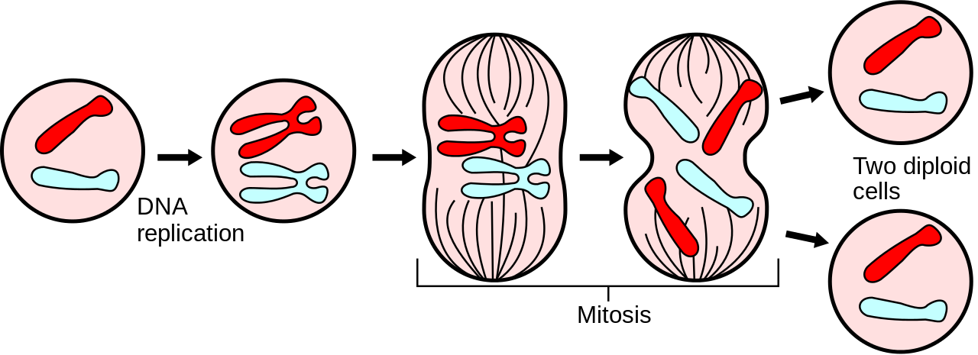
But where do processes come from?
In Linux, processes propagate by mitosis!
fork and (more recently) clone are system calls that create a nearly exact copy of the calling process: a parent and a child.
Later, the child process usually uses the execve syscall to replace itself with another process.
Example:
you type /bin/cat in bash
bash forks itself into the old parent process and the child process
the child process execves /bin/cat, becoming /bin/cat

Slide 83
Process Lifecycle: Loading

Slide 84
Can we load?
Before anything is loaded, the kernel checks for executable permissions.
If a file is not executable, execve will fail.

Slide 85
What to load?
To figure out what to load, the Linux kernel reads the beginning of the file (i.e., /bin/cat), and makes a decision:
If the file starts with #!, the kernel extracts the interpreter from the rest of that line and executes this interpreter with the original file as an argument.
If the file matches a format in /proc/sys/fs/binfmt_misc, the kernel executes the interpreter specified for that format with the original file as an argument.
If the file is a dynamically-linked ELF, the kernel reads the interpreter/loader defined in the ELF, loads the interpreter and the original file, and lets the interpreter take control.
If the file is a statically-linked ELF, the kernel will load it.
Other legacy file formats are checked for.
These can be recursive!
Further reading: https://0xax.gitbooks.io/linux-insides/content/SysCall/linux-syscall-4.html

Slide 86
Dynamically linked ELFs: the interpreter
Process loading is done by the ELF interpreter specified in the binary.
$ readelf -a /bin/cat | grep interpret
[Requesting program interpreter: /lib64/ld-linux-x86-64.so.2]
Colloquially known as "the loader".
Can be overridden: /lib64/ld-linux-x86-64.so.2 /bin/cat /flag
Or changed permanently: patchelf --set-intepreter
Further reading: https://0xax.gitbooks.io/linux-insides/content/SysCall/linux-syscall-4.html

Slide 87
Dynamically linked ELFs: the loading process
The program and its interpreter are loaded by the kernel.
The interpreter locates the libraries.
  LD_PRELOAD environment variable, and anything in /etc/ld.so.preload
  LD_LIBRARY_PATH environment variable (can be set in the shell)
  DT_RUNPATH or DT_RPATH specified in the binary file (both can be modified with patchelf)
  system-wide configuration (/etc/ld.so.conf)
  /lib and /usr/lib
The interpreter loads the libraries.
  these libraries can depend on other libraries, causing more to be loaded
  relocations updated
Further reading: https://0xax.gitbooks.io/linux-insides/content/SysCall/linux-syscall-4.html

Slide 88
Where is all this getting loaded to?
Each Linux process has a virtual memory space. It contains:
the binary
the libraries
the "heap" (for dynamically allocated memory)
the "stack" (for function local variables)
any memory specifically mapped by the program
some helper regions
kernel code in the "upper half" of memory (above 0x8000000000000000 on 64-bit architectures), inaccessible to the process
Virtual memory is dedicated to your process.
Physical memory is shared among the whole system.
You can see this whole space by looking at /proc/self/maps
Good resource: https://gist.github.com/CMCDragonkai/10ab53654b2aa6ce55c11cfc5b2432a4

Slide 89
The Standard C Library
libc.so is linked by almost every process.
Provides functionality you take for granted:
printf()
scanf()
socket()
atoi()
malloc()
free()
... and a lot of other crazy stuff!
xdr_keystatus()

Slide 90
The loading process (for statically linked binaries)
The binary is loaded.

Slide 91
Process Lifecycle: Execution

Slide 92
Your program has launched!
A normal ELF first calls __libc_start_main() in libc, which in turn calls the program's main() function.
Your code is running!
Now what?

Slide 93
Initial Input
int main(int argc, void **argv, void **envp);
Your process's entire input from the outside world, at launch, comprises of:
the loaded objects (binaries and libraries)
command-line arguments in argv
"environment" in envp
Of course, processes need to keep interacting with the outside world.

Slide 94
Process Lifecycle: Doing Stuff

Slide 95
Using library functions
The binary's import symbols have to be resolved using the libraries' export symbols.
In the past, this was an on-demand process and carried great peril.
In modern times, this is all done when the binary is loaded, and is much safer.
We'll explore this further in the future.

Slide 96
Interacting with the environment
Almost all programs have to interact with the outside world!
This is primarily done via system calls (man syscalls). Each system call is well-documented in section 2 of the man pages (i.e., man 2 open).
We can trace process system calls using strace.

Slide 97
System Calls
System calls have very well-defined interfaces that very rarely change.
There are over 300 system calls in Linux. Here are some examples:
int open(const char *pathname, int flags) - returns a file new file descriptor of the open file (also shows up in /proc/self/fd!)
ssize_t read(int fd, void *buf, size_t count) - reads data from the file descriptor
ssize_t write(int fd, void *buf, size_t count) - writes data to the file descriptor
pid_t fork() - forks off an identical child process. Returns 0 if you're the child and the PID of the child if you're the parent.
int execve(const char *filename, char **argv, char **envp) - replaces your process.
pid_t wait(int *wstatus) - wait child termination, return its PID, write its status into *wstatus.
long syscall(long syscall, ...) - invoke specified syscall.
Typical signal combinations:
fork, execve, wait (think: a shell)
open, read, write (cat)

Slide 98
Signals
System calls are a way for a process to call into the OS. What about the other way around?
Enter: signals. Relevant system calls:
sighandler_t signal(int signum, sighandler_t handler) - register a signal handler
int sigaction(int signum, const struct sigaction *act, struct sigaction *oldact) - more modern way of registering a signal handler
int kill(pid_t pid, int sig) - send a signal to a process.
Signals pause process execution and invoke the handler.
Handlers are functions that take one argument: the signal number.
Without a handler for a signal, the default action is used (often, kill).
SIGKILL (signal 9) and SIGSTOP (signal 19) cannot be handled.

Slide 99
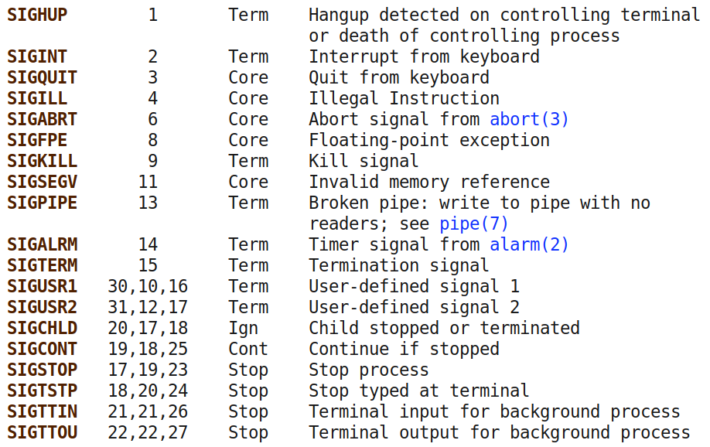
Signals
Full list in section 7 of man (man 7 signal) and kill -l. Common signals:

Slide 100
Shared memory
Another way of interacting with the outside world is by sharing memory with other processes.
Requires system calls to establish, but once established, communication happens without system calls.
Easy way: use a shared memory-mapped file in /dev/shm.

Slide 101
Process Lifecycle: Termination

Slide 102
Process termination
Processes terminate by one of two ways:
Receiving an unhandled signal.
Calling the exit() system call: int exit(int status)
All processes must be "reaped":
after termination, they will remain in a zombie state until they are wait()ed on by their parent.
When this happens, their exit code will be returned to the parent, and the process will be freed.
If their parent dies without wait()ing on them, they are
re-parented to PID 1 and will stay there until they're
cleaned up.

Slide 103
Debugging: strace

Slide 104
Debugging: ltrace

Slide 105
Debugging: gdb

Slide 106
Debugging: scripting gdb

