Slide 1
Introduction
What is Computer Systems Security?
Yan Shoshitaishvili
Arizona State University

Slide 2
What is Computer Systems Security?

Slide 3
What is Computer Systems Security?

Slide 4


Slide 5
What is Computer Systems Security?

Slide 6


Slide 7
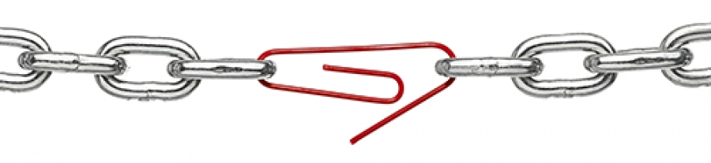
A chain is only as strong as its weakest link.

Slide 8
What is Computer Systems Security?

Slide 9
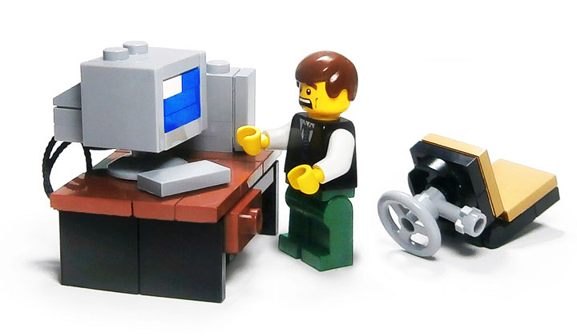

Slide 10
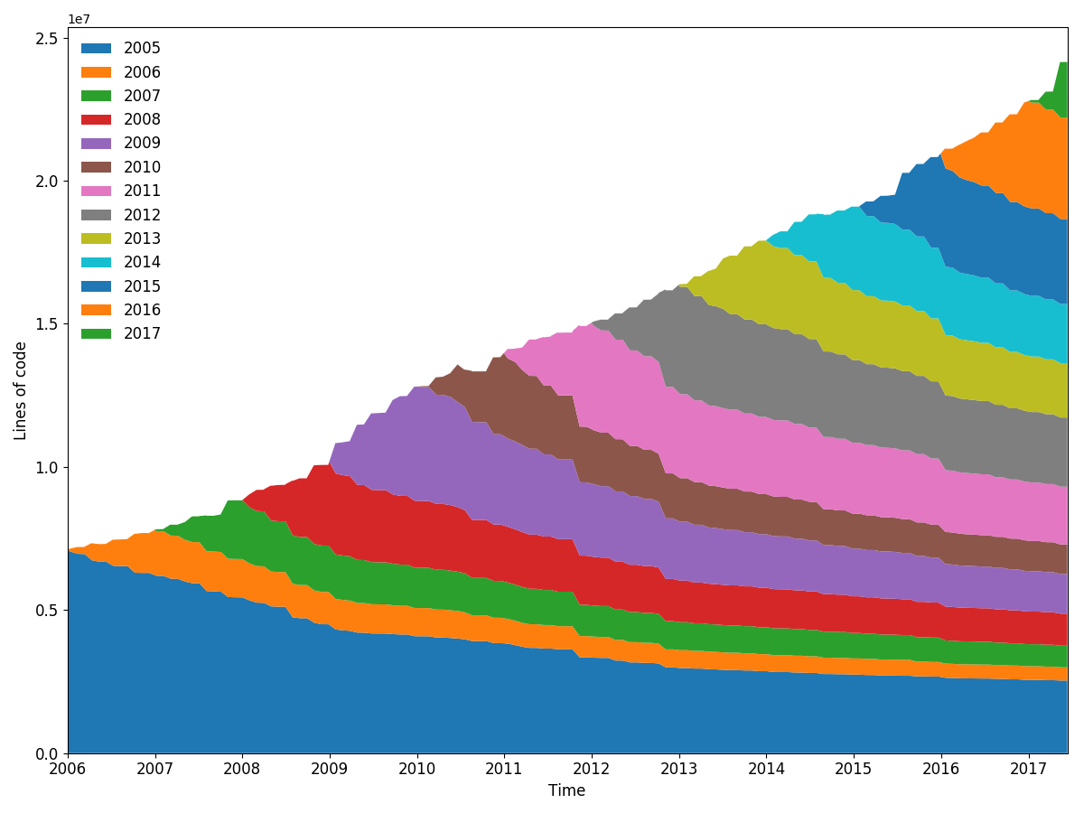
Computer System Complexity is Growing
Lines of code (in the Linux kernel)
Time

Slide 11
Modern computer systems are complex.
With great complexity comes great vulnerability...

Slide 12
What is Computer Systems Security?

Slide 13


Slide 14
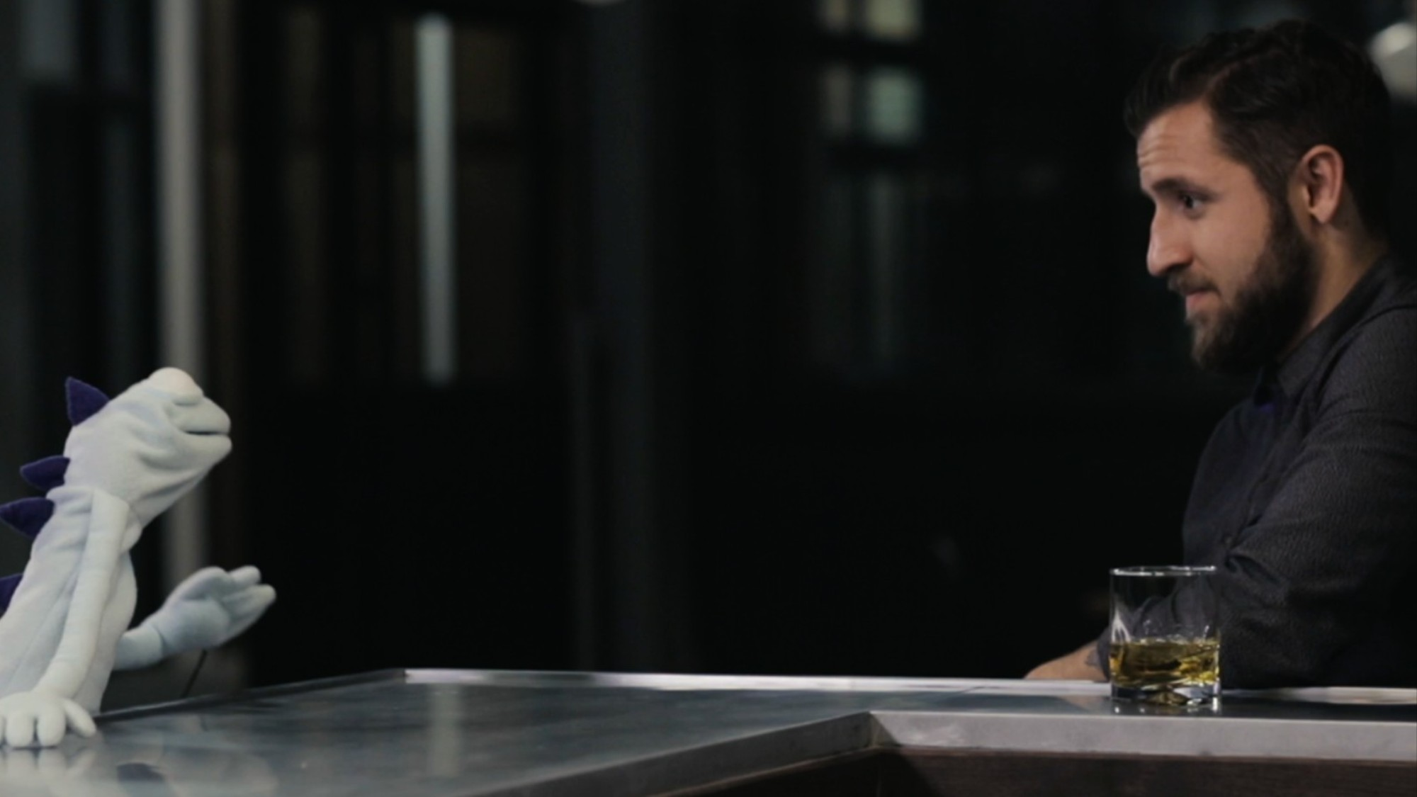

Slide 15
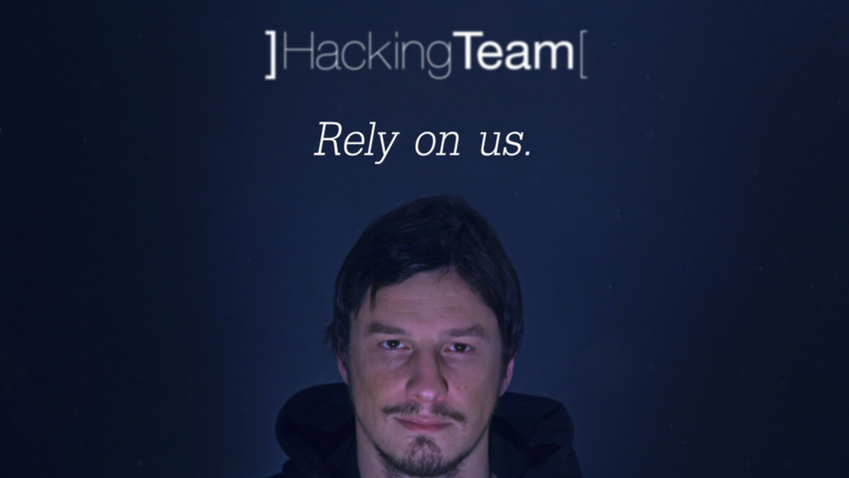

Slide 16
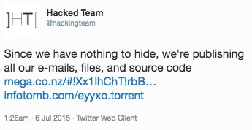

Slide 17
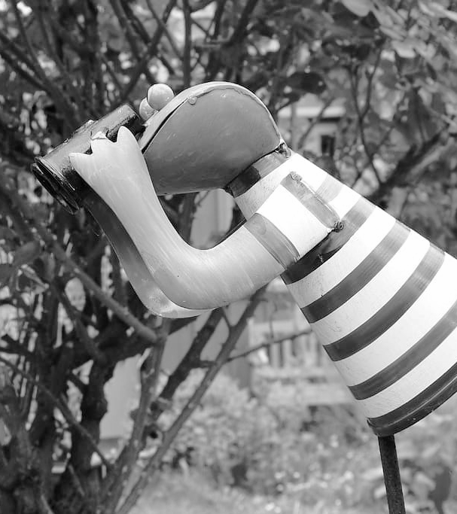
Hacking the Hackers
Step 1: Reconnaissance.
Hacking team was careful:
Little network-facing infrastructure (web server, mail server, VPN appliance, routers).
Low public profile.
Professional external security practices.
https://gist.github.com/Jyny/ceec95b654849762d183b337d39c4cf4

Slide 18

Hacking the Hackers
Step 2: Gaining a foothold.
Phineas Fisher discovered and exploited a zero-day vulnerability in one of the dedicated devices.
https://gist.github.com/Jyny/ceec95b654849762d183b337d39c4cf4

Slide 19

Hacking the Hackers
Step 3: Internal reconnaissance.
Phineas had the luxury of taking it slow and steady.
Passive network listening.
Careful, slow active network scanning.
This yielded an unsecured server with all the audio recording of the physical security system.
https://gist.github.com/Jyny/ceec95b654849762d183b337d39c4cf4

Slide 20
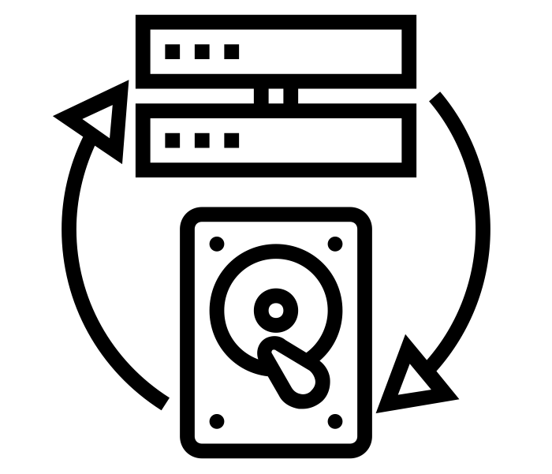
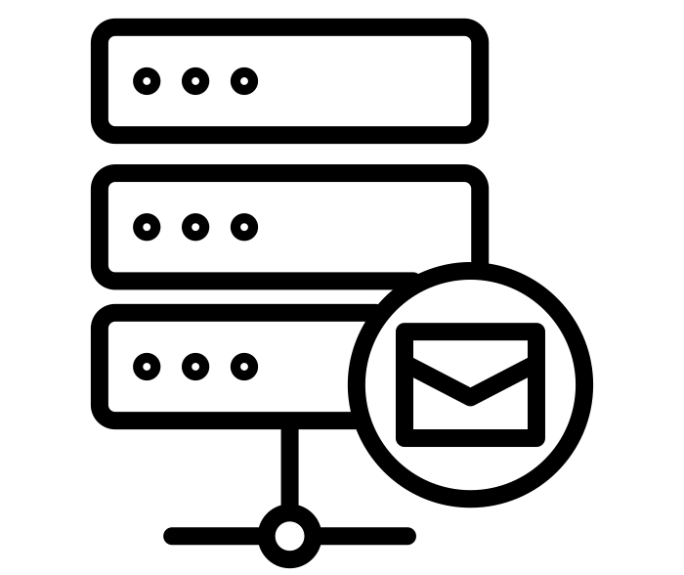
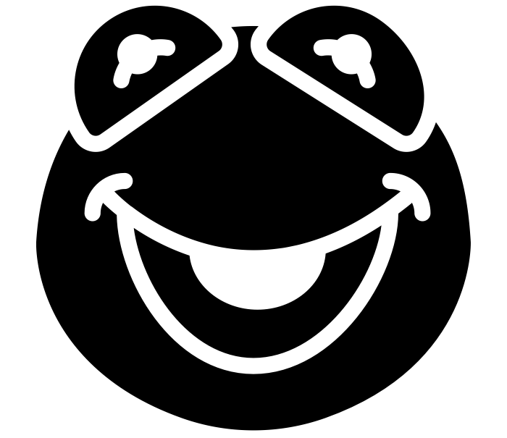

Hacking the Hackers
Step 4: Gaining influence in the network.
https://gist.github.com/Jyny/ceec95b654849762d183b337d39c4cf4

Slide 21





Hacking the Hackers
Step 5: Total compromise.
https://gist.github.com/Jyny/ceec95b654849762d183b337d39c4cf4
http://pastebin.com/raw/0SNSvyjJ

Slide 22
Hacking the Hackers
Step 6: Gloating.
https://gist.github.com/Jyny/ceec95b654849762d183b337d39c4cf4

Slide 23
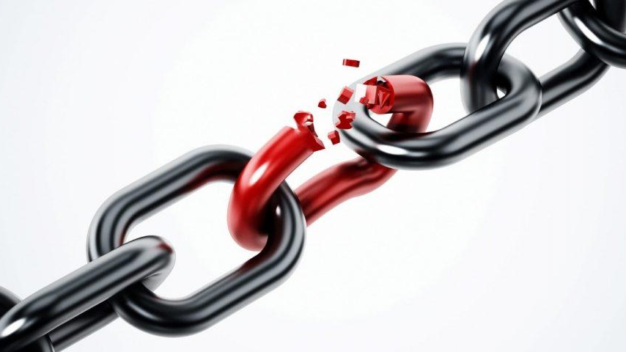
Embedded device 0day

Slide 24
What went wrong?
Weak links!
Vulnerable network-facing infrastructure (but what could they have done?)
Physical security system without digital security.
Failure to isolate backup storage system.
Continued use of stale password on mail server (and probably others).
Every-day user accounts that had Domain Administrator privileges.
Known vulnerability in monitoring system.
Link between production and development systems (probably necessary).
Password reuse.
Lack of two-factor authentication.
What would you have done differently, for your company?

Slide 25
Discussion: ethics of Hacking Team Hack?

Slide 26
Hacking Groundrules
RULE NUMBER ONE: Don't do anything illegal!
What does this mean in a hacking context?
NEVER EVER EVER EVER EVER hack into a system that you do not have explicit permission to hack.
Never attempt to find vulnerabilities in a system that you do not own or have permission to audit.
How do you practice? (more on this later)
Run a server for yourself to hack.
Stick to software and services with bug bounty programs.
Become an academic get some (limited) exceptions.
Become part of the competitive hacking community.

Slide 27
Takeaways
There is an Attack/Defense assymetry
  A chain is only as strong as its weakest link.
  To win, the defender has to block every attack.
  To win, the attacker has to succeed just once.
Even good defenses fail!
Hackers (cybersecurity professionals) have to be careful around ethics.

