Slide 1
Introduction
Computer Systems and Security?
Yan Shoshitaishvili Arizona State University

Slide 2
What is Computer Systems Security?

Slide 3
What is Computer Systems Security?

Slide 4
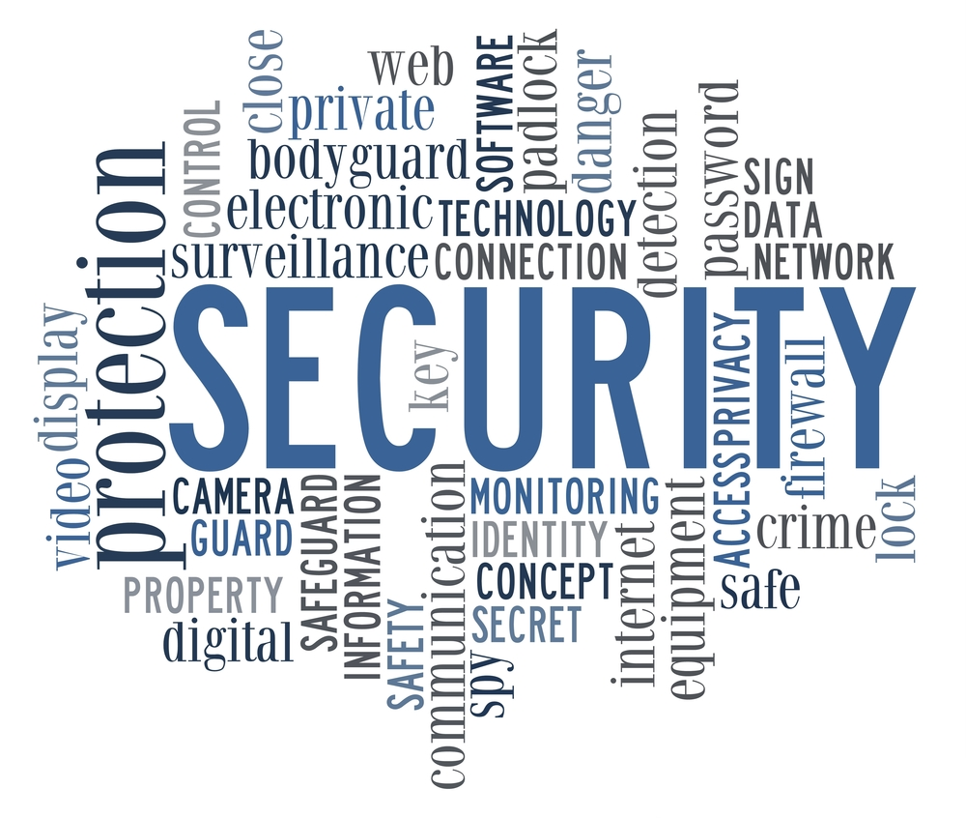

Slide 5
What is Computer Systems Security?

Slide 6
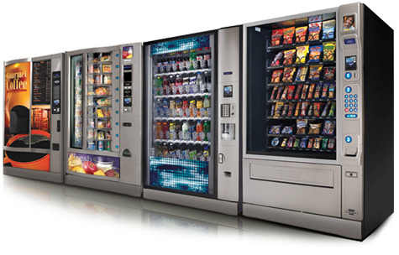

Slide 7
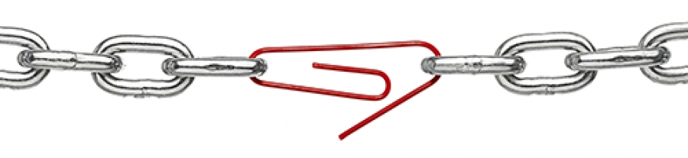
A chain is only as strong as its weakest link.

Slide 8
What is Computer Systems Security?

Slide 9
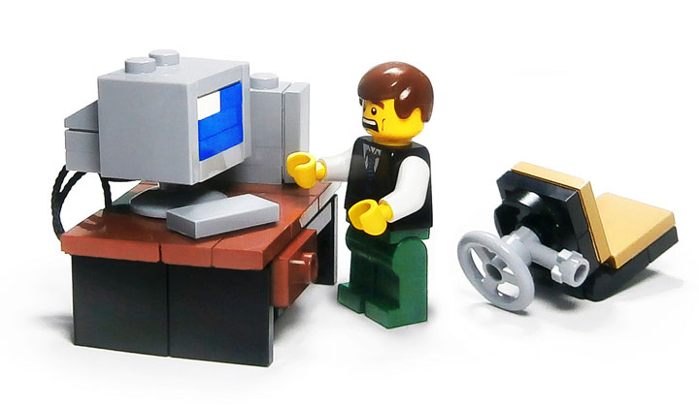

Slide 10
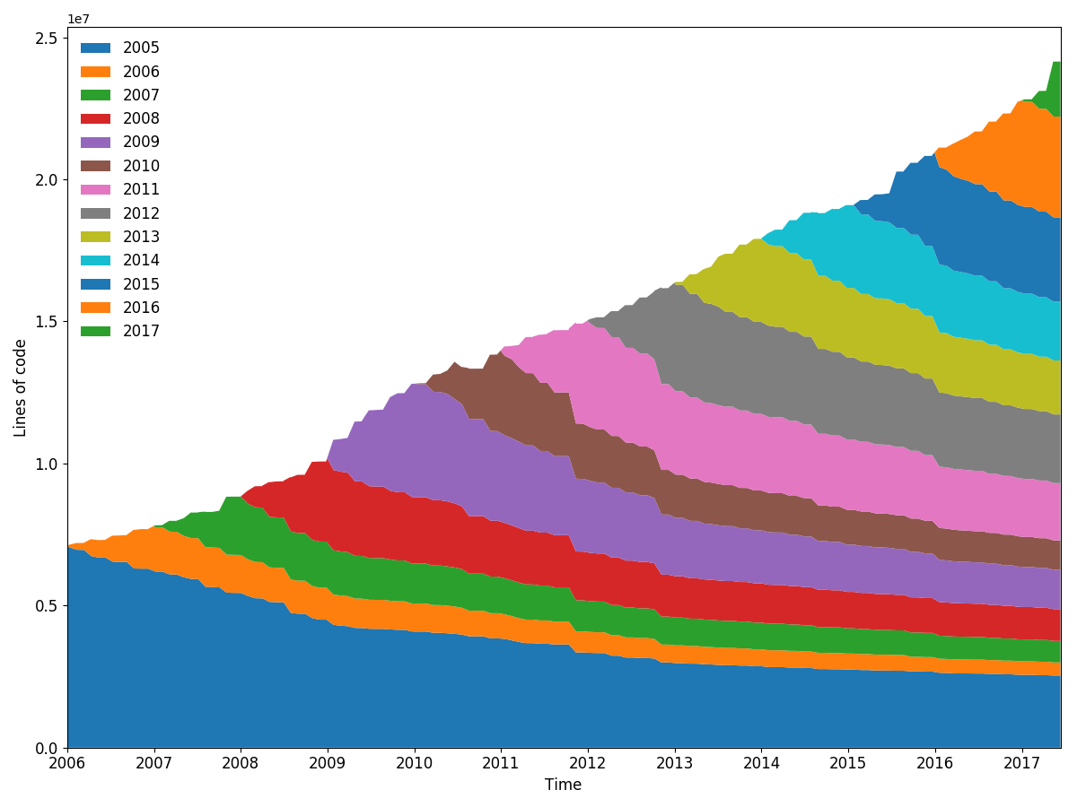
Computer System Complexity is Growing
Lines of code (in the Linux kernel)
Time

Slide 11
Modern computer systems are complex.
With great complexity comes great vulnerability...

