Slide 1
Introduction
What is Computer Systems Security?
Yan Shoshitaishvili
Arizona State University

Slide 2
What is Computer Systems Security?

Slide 3


Slide 4


Slide 5


Slide 6


Slide 7

Hacking the Hackers
Step 1: Reconnaissance.
Hacking team was careful:
Little network-facing infrastructure (web server, mail server, VPN appliance, routers).
Low public profile.
Professional external security practices.
https://gist.github.com/Jyny/ceec95b654849762d183b337d39c4cf4

Slide 8

Hacking the Hackers
Step 2: Gaining a foothold.
Phineas Fisher discovered and exploited a zero-day vulnerability in one of the dedicated devices.
https://gist.github.com/Jyny/ceec95b654849762d183b337d39c4cf4

Slide 9

Hacking the Hackers
Step 3: Internal reconnaissance.
Phineas had the luxury of taking it slow and steady.
Passive network listening.
Careful, slow active network scanning.
This yielded an unsecured server with all the audio recording of the physical security system.
https://gist.github.com/Jyny/ceec95b654849762d183b337d39c4cf4

Slide 10
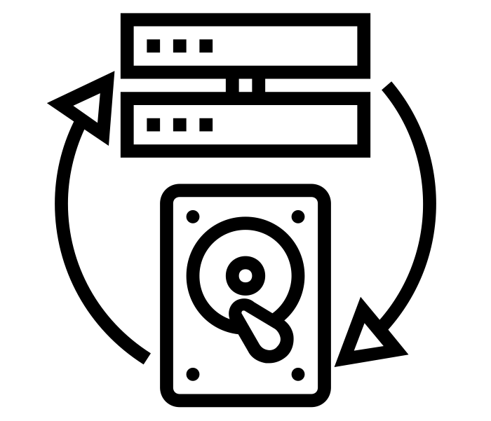
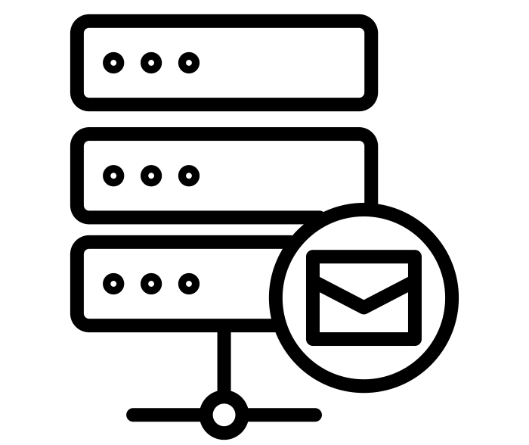
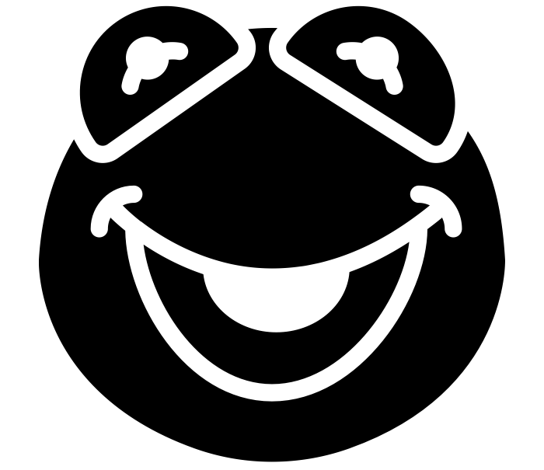

Hacking the Hackers
Step 4: Gaining influence in the network.
https://gist.github.com/Jyny/ceec95b654849762d183b337d39c4cf4

Slide 11

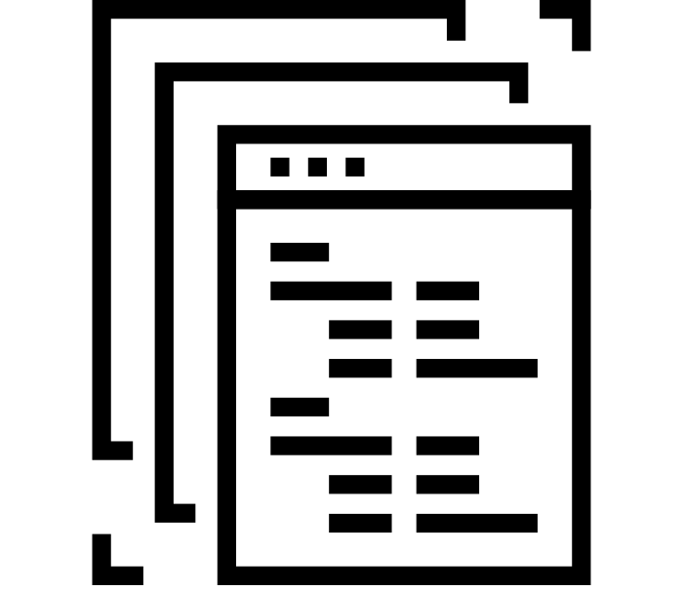

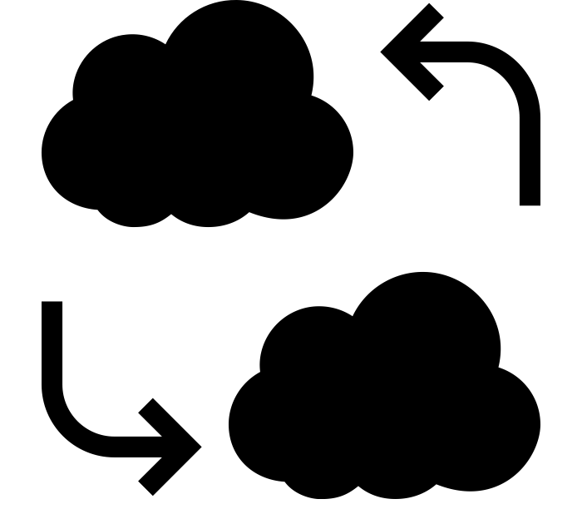

Hacking the Hackers
Step 5: Total compromise.
https://gist.github.com/Jyny/ceec95b654849762d183b337d39c4cf4
http://pastebin.com/raw/0SNSvyjJ

Slide 12
Hacking the Hackers
Step 6: Gloating.
https://gist.github.com/Jyny/ceec95b654849762d183b337d39c4cf4

Slide 13
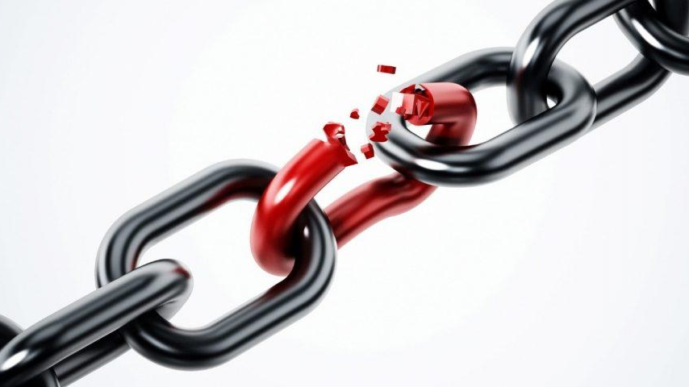
Embedded device 0day

Slide 14
What went wrong?
Weak links!
Vulnerable network-facing infrastructure (but what could they have done?)
Physical security system without digital security.
Failure to isolate backup storage system.
Continued use of stale password on mail server (and probably others).
Every-day user accounts that had Domain Administrator privileges.
Known vulnerability in monitoring system.
Link between production and development systems (probably necessary).
Password reuse.
Lack of two-factor authentication.
What would you have done differently, for your company?

Slide 15
Takeaways
There is an Attack/Defense asymmetry
  A chain is only as strong as its weakest link.
  To win, the defender has to block every attack.
  To win, the attacker has to succeed just once.
Even good defenses fail!

