Slide 1
Module: Outroduction
Careers
Yan Shoshitaishvili Arizona State University

Slide 2
So you still want to be a hacker...

Slide 3
How to keep learning...

Slide 4
Capture the Flag: Live Cybersecurity Exercises
Don't forget to play CTF.
CTFs teach you cutting-edge cybersecurity concepts and develop your on-the-spot learning abilities while forcing you to think in a cybersecurity mindset.
Online resources:
CTF directory, writeups, etc: https://ctftime.org
List of practice "wargames": https://github.com/zardus/wargame-nexus

Slide 5
The "Olympics" of Hacking: DEF CON CTF
Takes place every year in Las Vegas (virtual for 2020).
Currently hosted by the Order of the Overflow (courtesy of yours truly!). https://oooverflow.io
Last year: 16 teams, probably about 300 of the best hackers in the world!
Had to qualify for the competition through qualifier events.
Three days of non-stop hacking insanity.
One winner, A*0*E: https://ctfradi.ooo/2020/10/20/007-dc28-winners-a0e.html#61aa9df3

Slide 6
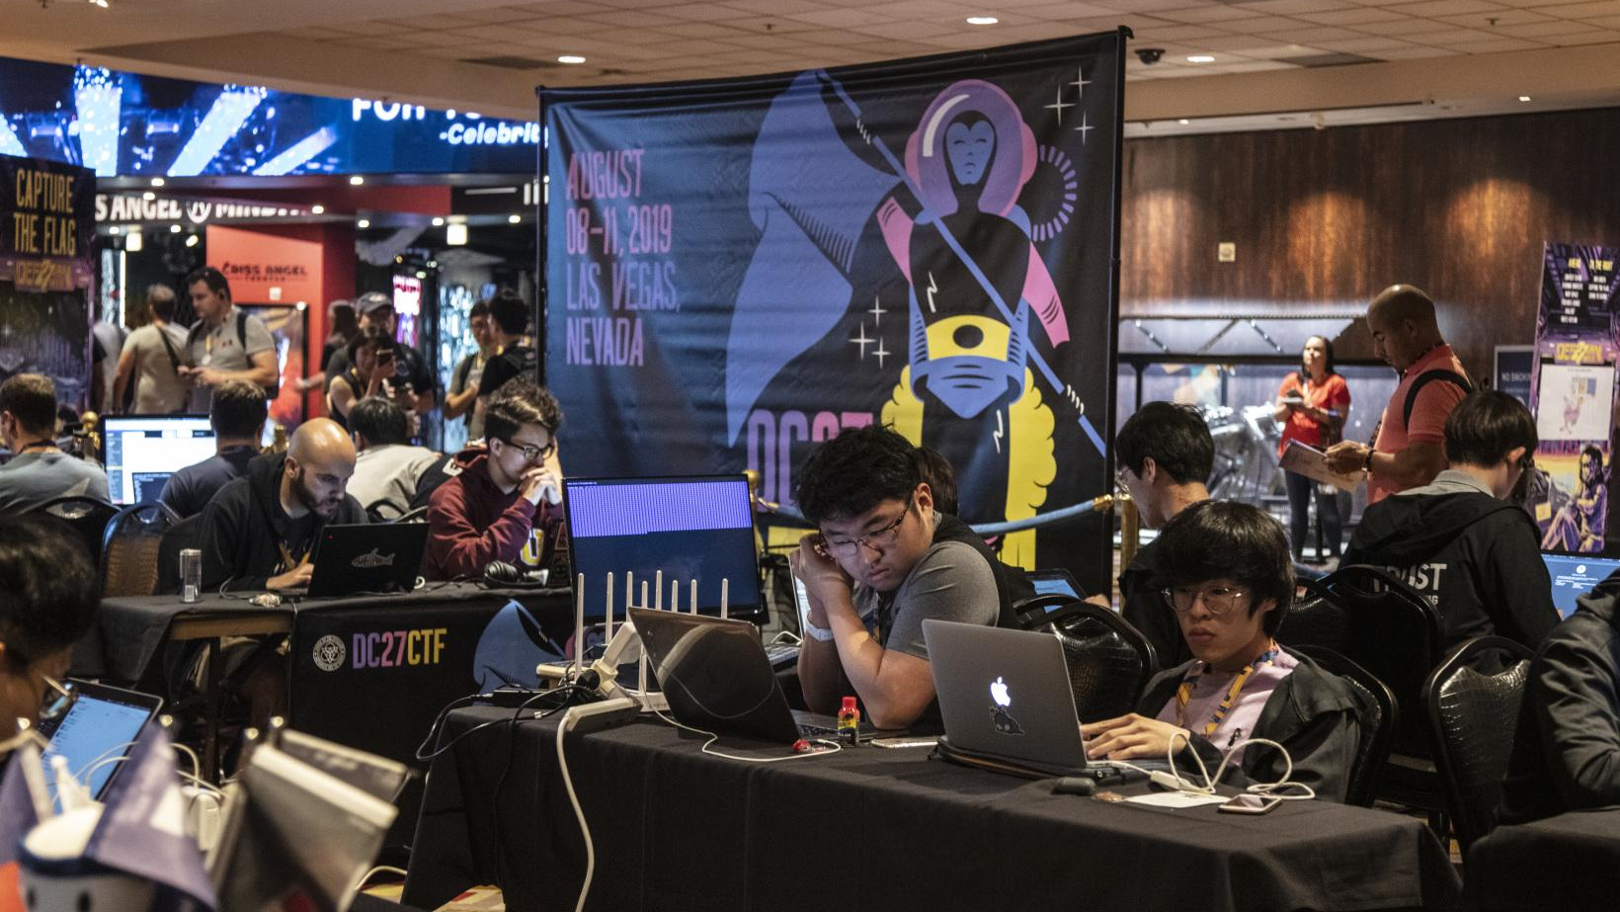

Slide 7
Bug Bounty Programs
A number of web sites and companies have started to offer Bug Bounty programs.
Earn money and fame for reporting security vulnerabilities.
Make sure that they give you permission (depending on the bug bounty program terms, you might have to explicitly register), and make sure you understand the rules and what is in scope.
Violating these rules can disqualify you from the program and subject you to legal consequences.
Google, Facebook, AT&T, Coinbase, Etsy, Github, Heroku, Microsoft, Paypal, https://bugcrowd.com/list-of-bug-bounty-programs
Significant rewards! Apple's top bug bounty amount is over $1,000,000.

Slide 8
"I found a vuln! What's next?"
DO NOT EXPLOIT IT IN THE WILD.
What are your options?
Tell the world (full disclosure)
considered to be bad form
Tell the company/group responsible for the software and give them a chance to fix it (responsible disclosure)
usually rewarded with public recognition (CVE entry)
often rewarded with money (bug bounty)
Demonstrate it in a 0-day contest, such as pwn2own.
Prizes up to $100,000 and much fame.
Sell the information to the grey or black market for $$$.
Market price of a remote iPhone 0day: approximately $2,000,000.
Market price of a limited Chrome 0day: approximately $200,000.

Slide 9
But how do I get good enough - CLASS EDITION
You survived CSE466. Now what?
Introducing (again!): CSE 598: Applied Vulnerability Research.
We will hack real-world software, submit bug reports, get CVEs!
Open to blue belts (or anyone with an A+).

Slide 10
But I want to change the world!
Stay in school!
You can hack your way through graduate school in SEFCOM, ASU's Systems Security research lab!
Work with awesome people!
Play CTF (sanctioned)!
Change the world with incredible security research!
Interested? Email me at yans@asu.edu.
This applies to ASU students and non-ASU students!

Slide 11
How to make a living...

Slide 12
100% Legal Hacker Career: Penetration Testing
Penetration Testers are hired by companies to penetrate the clients' networks/systems and thus identify security issues.
Pro: Breaking into actual companies on their request. Pro: Wide range of targets.
Con: Generally (but definitely not exclusively!) dealing with unpatched systems, configuration issues, checking best-practices. Con: Anecdotally, can get repetitive seeing the same silly security issues. Con: A lot of report writing for non-technical audiences. Con: Time pressure to deliver results.
Tooling: nmap, nessus, burp, metasploit
Local Example: Bishop Fox

Slide 13
100% Legal Hacker Career: In-house Security Engineer
Large companies maintain in-house teams of security engineers to make sure their software and infrastructure is secure.
Pro: Stable gig, easy escape path into other parts of the company. Pro: Generally allotted adequate time to explore security properties.
Con: Lower variety among targets. Con: (possibly outdated) Internal politics can depriorize security.
Tooling: AFL, libfuzzer, custom fuzzers, burp, CodeQL, internal tooling.
Local Example: any sufficiently large local company!

Slide 14
100% Legal Hacker Career: Government Security Engineer
The government maintains teams of security engineers to make sure US software and infrastructure is secure.
Pro: Very stable gig. Pro: Generally allotted adequate time to explore security properties.
Con: Public sector pays worse. Con: Clearance requirements.
Tooling: AFL, libfuzzer, custom fuzzers, burp, CodeQL, internal tooling.

Slide 15
100% Legal Hacker Career: Vulnerability Researcher
Companies work for clients to identify security vulnerabilities in third party software.
Pro: Cybersecurity rock bands. Pro: Wide variety of targets to explore.
Con: Pressure to deliver. Con: Large drama potential. Con: Potential ethical concerns (e.g., Hacking Team).
Tooling: AFL, custom fuzzers, IDA.
Local Examples:
Cisco Talos
ASU CSE 598!

Slide 16




100% Legal Hacker Career: Professor
Go to graduate school, do great, become a professor, get tenure, job for life!
Pro: Academic freedom. Pro: Unfireable! (Eventual) low pressure. Pro: Perpetually involved with cutting-edge research. Pro: Constantly around tons of brilliant, motivated people. Pro: Strong legal umbrella.
Con: Public sector pays worse. Con: Academic bureaucracy can be daunting. Con: Extreme pressure early on.
Tooling: Google Slides, ipython, latex.
Local Examples:

Slide 17

100% Legal Hacker Career: Freelance Hacker
Like the Vulnerability Researcher, but on your own. Income from bug bounties ($), pwn2own-style competitions ($$), or bug sales ($$$).
Pro: Cybersecurity Rock Star. Pro: Can be extremely lucrative.
Con: No safety net. Con: No legal umbrella. Con: Potential ethical concerns.
Tooling: AFL, custom fuzzers, IDA.
Example:

