Slide 1
Privilege Escalation
Introduction
Yan Shoshitaishvili
Arizona State University

Slide 2
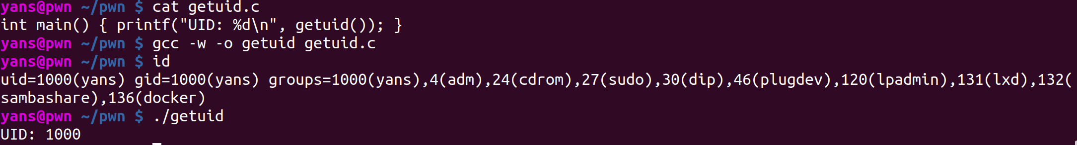
Recall the Linux permission model
Every process has a user ID and a GID.
Every file and directory is owned by a user and group.
Child processes inherit from parent processes.

Slide 3
Some UIDs are better than others...
UID 0 is the Linux administrator user, root. Roughly speaking, you need root for:
Installing software.
Loading device drivers.
Shutting down, rebooting.
Changing system-wide settings.
But if you're UID 1000, how do you become UID 0?

Slide 4
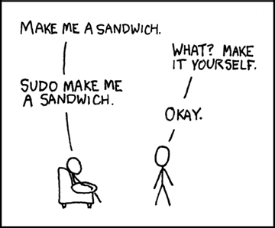
Privilege Elevation
One way to elevate your privileges is to run an suid binary.
SUID is a bit in the Linux permission model:
SUID: execute with the eUID of the file owner rather than the parent process.
SGID: execute with the eGID of the file owner rather than the parent process.
Sticky: used for shared directories to limit file removal to file owners.
Common examples of SUID binaries: sudo, su, newgrp
https://xkcd.com/149
SUID
User Read
User Write
User Exec
SGID
Group Read
Group Write
Group Exec
Sticky
World Read
World Write
World Exec

Slide 5
Quick Detour: e UID?
Three different type of user and group IDs:
Effective (eUID, eGID): the UID/GID used for most access checks.
Real (UID, GID): the "real" UID (or GID) of the process owner, used for things such as signal checks.
Saved: a UID/GID that your process could switch its eUID/eGID to. Used for temporarily dropping privileges.

Slide 6
With great power comes great responsibility...
eUID 0 is powerful. Aside from system management, root can (by default):
Open any file!
Including things in the special /proc filesystem!
And device-backed files!
Execute any program.
Assume any other UID or GID.
Debug any program.
Obviously, this can be a security disaster...

Slide 7
Privilege Escalation
Privilege Escalation is a class of exploit in which the
attacker elevates their privileges to (generally) root level.
Typical flow:
Gain a foothold on the system (vulnerable network service, intended shell access, code in app context, etc).
Identify a vulnerable privileged service.
Exploit the privileged service to gain its privileges.
Example: if an SUID binary has a security problem, an attacker can use it in a privilege escalation attack:

Slide 8
Security Woes
Who would be this careless?
Vulnerabilities in SUID binaries, such as sudo:
  CVE-2019-14287: privilege escalation under certain configurations.
  CVE-2018-10852: permission misconfiguration leading to privilege escalation
  CVE-2017-1000367: improper input sanitization leading to command execution
  CVE-2016-7076: privilege escalation under certain invocation scenarios
  CVE-2016-7091: privileged information disclosure
  CVE-2015-5602: privilege escalation under certain configurations
  CVE-2014-0106: bypass of configuration restrictions
Unnecessary SUDOing (or running as root by other means)
other software.
  Depressingly common in course grading systems, other shared server management software.
  Too common with containerization (docker's default user is root).
OS-level vulnerabilities (stay tuned!).

Slide 9
Practice Problems!
This module's practice problems:
Connect to pwn.college.
Select a program path to unnecessarily SUID.
  TONS of programs can be chosen, but not everything is viable to read the flag with...
Use this program to read /flag, if you can!
Let's demo a few:
/bin/cat
/usr/bin/more
/usr/bin/find

