Slide 1
Module 6: Exploitation Scenarios
Introduction: Achieving Control
Yan Shoshitaishvili
Arizona State University

Slide 2
You have learned the building blocks... now what?

Slide 3
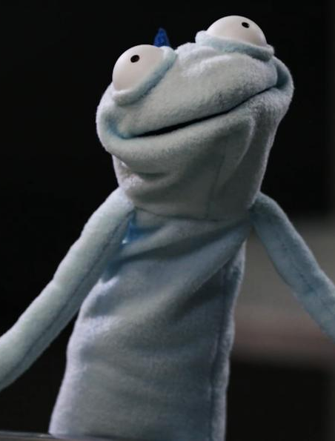
Remember Phineas Fisher
Phineas Fisher compromised Hacking Team step by step.
External reconnaissance.
Gaining a foothold.
Internal reconnaissance.
Gaining influence in the network.
Total compromise.
Gloating.
Reminder: https://pwn.college/modules/intro

Slide 4
Think like Phineas Fisher
1. External reconnaissance. Look at the program. Understand it. How does it work? What might be potential vulnerable functionality?
2. Gaining a foothold. Find the teenies tiniest security hole. Exploit it!
3. Internal reconnaissance. What does your vulnerability change in the program state? What else does this allow you to do?
4. Gaining influence. Exploit the security hole(s) your initial corruption opened up.
5. Total compromise. Repeat steps 3 and 4 until the system is totally broken.
6. Gloating. Get and submit the flag!

Slide 5


