Slide 1
Module: Dynamic Allocator Misuse
Heap Metadata Corruption
Yan Shoshitaishvili
Arizona State University

Slide 2
Recap: Metadata Corruption Goals
What might we want to achieve with heap metadata corruption?
Modify arbitrary memory.
Achieve an overlapping allocation (with other heap structures, stack, etc).
Use either of those capabilities for further control.

Slide 3
Historical: The Unlink Attack
struct malloc_chunk { unsigned long mchunk_prev_size;
unsigned long mchunk_size; struct malloc_chunk* fd; struct malloc_chunk* bk; struct malloc_chunk* fd_nextsize; struct malloc_chunk* bk_nextsize; }; typedef struct malloc_chunk* mchunkptr;
Recall the struct (to the right).
When a chunk (bigger than the tcache size) is allocated, it is removed from the doubly-linked list. This looks like:
chunk->fd->bk = chunk->bk;
chunk->bk->fd = chunk->fd;

Slide 4
Historical: The Unlink Attack
struct malloc_chunk { unsigned long mchunk_prev_size;
unsigned long mchunk_size; struct malloc_chunk* fd; struct malloc_chunk* bk; struct malloc_chunk* fd_nextsize; struct malloc_chunk* bk_nextsize; }; typedef struct malloc_chunk* mchunkptr;
chunk B
fd: &C
bk: &A
chunk A
chunk C
fd: &B
fd: NULL
bk: NULL
bk: &B

Slide 5
Historical: The Unlink Attack
struct malloc_chunk { unsigned long mchunk_prev_size;
unsigned long mchunk_size; struct malloc_chunk* fd; struct malloc_chunk* bk; struct malloc_chunk* fd_nextsize; struct malloc_chunk* bk_nextsize; }; typedef struct malloc_chunk* mchunkptr;
chunk B
fd: &C
bk: &A
chunk A
chunk C
fd: &B
fd: NULL
bk: NULL
bk: &B

Slide 6
Historical: The Unlink Attack
struct malloc_chunk { unsigned long mchunk_prev_size;
unsigned long mchunk_size; struct malloc_chunk* fd; struct malloc_chunk* bk; struct malloc_chunk* fd_nextsize; struct malloc_chunk* bk_nextsize; }; typedef struct malloc_chunk* mchunkptr;
Recall the struct (to the right).
When a chunk (bigger than the tcache size) is allocated, it is removed from the doubly-linked list. This looks like:
chunk->fd->bk = chunk->bk;
chunk->bk->fd = chunk->fd;
If you control chunk->fd and chunk->bk, you can overwrite an arbitrary location in memory with an arbitrary (but valid) pointer.
Extra checks (chunk->fd->bk == chunk && chunk->bk->fd == chunk) have heavily weakened this attack (though you can still pass this check if you inject a chunk!).

Slide 7
Historical: Poison Null Byte
struct malloc_chunk { unsigned long prev_size;
unsigned long size; struct malloc_chunk* fd; struct malloc_chunk* bk; struct malloc_chunk* fd_nextsize; struct malloc_chunk* bk_nextsize; };
What if all we have is a single 0-byte write? This is common, with off-by-one string operations!
buf = malloc(0x1008);
int read_length = read(0, 0x1008, 128);
buf[read_length] = 0;
What's the problem here?

Slide 8
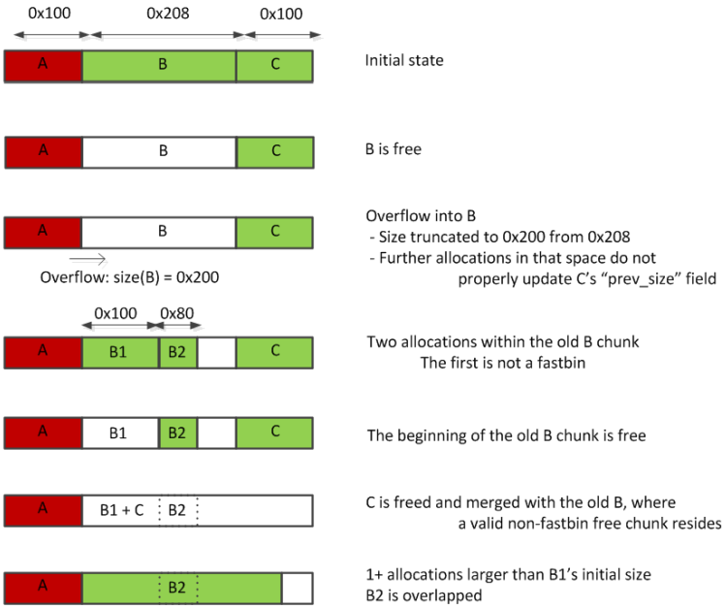
Historical: Poison Null Byte
struct malloc_chunk { unsigned long prev_size;
unsigned long size; struct malloc_chunk* fd; struct malloc_chunk* bk; struct malloc_chunk* fd_nextsize; struct malloc_chunk* bk_nextsize; };
Figure source: https://heap-exploitation.dhavalkapil.com/attacks/shrinking_free_chunks.html

Slide 9
Historical: House of Force
My personal favorite house, but now patched...
The wilderness is just hanging out on the heap!
What if we overwrite it with a humongous number?
We could control where stuff will be allocated, and get an overlapping allocation!!!

Slide 10
House of Spirit
Straight-forward: exploit the fact that there are very few checks done at free() time!
Forge something that looks like a chunk.
free() it.
The next malloc() will return that chunk to you!
With a pointer overwrite, can be used to later malloc() a stack pointer.
Can be done with or without tcache.

Slide 11
Miscellaneous Heapery
How do you trigger a malloc() in an uncooperative program?
printf(), scanf(), and friends will use malloc() to allocate space during operation!
With the right setup, can lead straight to an overwrite.
If you want to disable this in your own programs:
setbuf(stdout, NULL); setbuf(stdin, NULL);

Slide 12
Major Heap Headache: Heap Massaging
Heap exploitation requires precise heap layout.
Programs are constantly messing with the heap.
Some automation is being worked on (https://www.usenix.org/conference/usenixsecurity18/presentation/heelan)!
Mastering this is hard.

Slide 13
Further reading
Educational heap exploitation resources by Shellphish: https://github.com/shellphish/how2heap
A guidebook on the heap:
https://heap-exploitation.dhavalkapil.com
Automated heap security analysis engine:
https://github.com/angr/heaphopper

