Slide 1
Module: Race Conditions
Introduction
Yan Shoshitaishvili Arizona State University

Slide 2
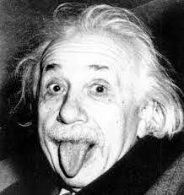
The only reason for time is so that everything doesn't happen at once.
— Albert Einstein

Slide 3
The Arrow of Time (human view)
Wake up
Breakfast
Work on pwn.college
Lunch
Work on pwn.college
Dinner
Work on pwn.college
Sleep

Slide 4
The Arrow of Time (process system)
initialize()
check_input()
do_action()
check_input()
do_action()
check_input()
do_action()
terminate()

Slide 5
The Arrow of Time (multi-process system)
initialize()
check_input()
do_action()
check_input()
do_action()
check_input()
do_action()
terminate()
Process 1
initialize()
check_input()
do_action()
check_input()
do_action()
check_input()
do_action()
terminate()
Process 2

Slide 6
The Arrow of Time (reality)
P1 initialize()
P2 initialize()
P1 check_input()
P2 check_input()
P1 do_action()
P2 do_action()
P1 check_input()
P2 check_input()
P1 do_action()
P2 do_action()
P1 check_input()
P2 check_input()
P1 do_action()
P2 do_action()
P1 terminate()
P2 terminate()

Slide 7
Why the single arrow of time?
Olden days: single core CPUs!
Modern times:
Multi-core, but still fewer cores than processes.
kernel decides what processes to "schedule" when
Limited-channel memory controllers (i.e., quad-channel memory)
Limited-channel storage media
Single-channel network communication
Bottom line: Bottlenecks in computing architecture cause concurrent events to be at least partially serialized.

Slide 8
Order of Execution
Without implicit dependencies or explicit effort by the program, execution order is only guaranteed within a process (really, within a thread).
Possible execution orderings for a "simultaneous" launch of P1 and P2:
P1 initialize()
P2 initialize()
P1 check_input()
P2 check_input()
P1 do_action()
P2 do_action()
P1 check_input()
P2 check_input()
P1 do_action()
P2 do_action()
P1 check_input()
P2 check_input()
P1 do_action()
P2 do_action()
P1 terminate()
P2 terminate()
P1 initialize()
P1 check_input()
P1 do_action()
P1 check_input()
P1 do_action()
P1 check_input()
P1 do_action()
P1 terminate()
P2 initialize()
P2 check_input()
P2 do_action()
P2 check_input()
P2 do_action()
P2 check_input()
P2 do_action()
P2 terminate()
P1 initialize()
P1 check_input()
P2 initialize()
P2 check_input()
P2 do_action()
P2 check_input()
P2 do_action()
P2 check_input()
P2 do_action()
P2 terminate()
P1 do_action()
P1 check_input()
P1 do_action()
P1 check_input()
P1 do_action()
P1 terminate()
P1 initialize()
P2 initialize()
P1 check_input()
P2 check_input()
P1 do_action()
P1 check_input()
P1 do_action()
P1 check_input()
P1 do_action()
P1 terminate()
P2 do_action()
P2 check_input()
P2 do_action()
P2 check_input()
P2 do_action()
P2 terminate()
P2 initialize()
P1 initialize()
P1 check_input()
P2 check_input()
P2 do_action()
P2 check_input()
P1 do_action()
P1 check_input()
P1 do_action()
P2 do_action()
P1 check_input()
P2 check_input()
P1 do_action()
P2 do_action()
P1 terminate()
P2 terminate()

Slide 9
TOCTOU: Time of Check / Time of Use
Some execution orderings can be buggy!
P1's do_action() might be taking actions in a changed world from the one examined by check_input()!
P1 initialize()
P2 initialize()
P1 check_input()
P2 check_input()
P1 do_action()
P2 do_action()
P1 check_input()
P2 check_input()
P1 do_action()
P2 do_action()
P1 check_input()
P2 check_input()
P1 do_action()
P2 do_action()
P1 terminate()
P2 terminate()
P1 initialize()
P1 check_input()
P1 do_action()
P1 check_input()
P1 do_action()
P1 check_input()
P1 do_action()
P1 terminate()
P2 initialize()
P2 check_input()
P2 do_action()
P2 check_input()
P2 do_action()
P2 check_input()
P2 do_action()
P2 terminate()
P1 initialize()
P1 check_input()
P2 initialize()
P2 check_input()
P2 do_action()
P2 check_input()
P2 do_action()
P2 check_input()
P2 do_action()
P2 terminate()
P1 do_action()
P1 check_input()
P1 do_action()
P1 check_input()
P1 do_action()
P1 terminate()
P1 initialize()
P2 initialize()
P1 check_input()
P2 check_input()
P1 do_action()
P1 check_input()
P1 do_action()
P1 check_input()
P1 do_action()
P1 terminate()
P2 do_action()
P2 check_input()
P2 do_action()
P2 check_input()
P2 do_action()
P2 terminate()
P2 initialize()
P1 initialize()
P1 check_input()
P2 check_input()
P2 do_action()
P2 check_input()
P1 do_action()
P1 check_input()
P1 do_action()
P2 do_action()
P1 check_input()
P2 check_input()
P1 do_action()
P2 do_action()
P1 terminate()
P2 terminate()

Slide 10
Racing to Victory
Abusing concurrency errors requires racing to carefully impact the state of an application during a weak point (for massive damage).
Hence: Race Condition
P1 initialize()
P1 check_input()
WEAK POINT
P1 do_action()
WEAK POINT
P1 check_input()
WEAK POINT
P1 do_action()
WEAK POINT
P1 check_input()
WEAK POINT
P1 do_action()
P1 terminate()

Slide 11
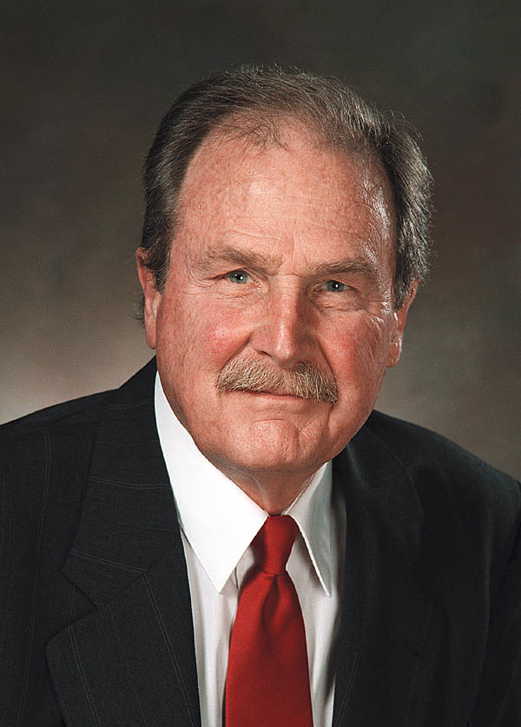
Race Conditions: A History
Race Conditions were originally discussed in a hardware context.
In 1954, David Huffman, of Huffman Encoding fame, wrote about them in his PhD dissertation, "The Synthesis of Sequential Switching Circuits".

