Slide 1
Module: Race Conditions
Signals and Reentrancy
Yan Shoshitaishvili Arizona State University

Slide 2
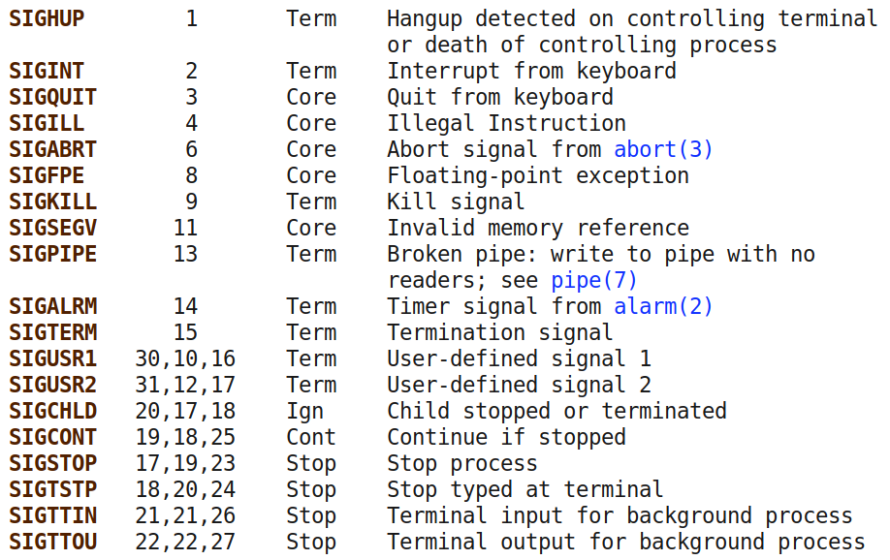
Recall: Signals
Send a signal to a process:
int kill(pid_t pid, int sig)

Slide 3
Handling Signals
Processes can register signal handlers to handle signals.
sighandler_t signal(int signum, sighandler_t handler) int sigaction(int signum, const struct sigaction *act, struct sigaction *oldact)
Effect: signals pause process execution and invoke the handler...
Access: you can send ANY signal to ANY process that has the same rUID as you, even if their eUID is 0.
Capability: this means that you can cause any program to suddenly and unexpectedly divert execution to the signal handler!
Note: this also works to yank programs out of a "critical section".

Slide 4
Offensive Signals
Recall the crazy issues that can arise when code runs in unexpected order!
int num = 0;
void signal_handler(int signum) {
num = 0;
}
int main() {
signal(SIGUSR1, signal_handler);
while (1) {
if (num == 0) num++;
num--;
if (num != 0) printf("NUM: %d\n", num);
}
}

Slide 5
Reentrancy
Reentrant function are functions that would operate properly even when interrupted with an instance of themselves.
01 int tmp;
02 void swap(int* x, int* y) {
03 tmp = *x;
04 *x = *y;
05 *y = tmp;
06 }
07
08 void call_swap() {
09 int x = 1, y = 2;
10 swap(&x, &y);
11 }
12
13 int main() { 14 signal(SIGUSR1, call_swap);
15 call_swap();
16 }
What happens if this program receives SIGUSR1 before line 5?
Note: none of these functions are reentrant!
https://en.wikipedia.org/wiki/Reentrancy_(computing)

Slide 6
Safe Signal Practices
Do not call non-reentrant functions in your signal handlers:
Your handler might have interrupted those functions mid-execution.
Another signal might interrupt your signal handler's non-reentrant invocations mid-execution!
Depending on settings (SA_NODEFER flag to sigaction()), another iteration of the same signal might interrupt your signal!
Note: malloc() and free() are not reentrant.
man signal-safety for more info.

Slide 7
Digging into Signal Delivery
When do signal handlers get triggered, really?
Time slice. The kernel gives your process a limited time "slices" in which to run. The kernel hijacks the CPU from your process at the end of a time slice. If your process does a system call close to the end of your timeslice, the kernel might confiscate the rest of your timeslice.
Signal checking. The kernel will check for received signals to your process, and trigger handlers, the next time it schedules your process for execution (either after a system call or at the beginning of a new time slice).
Takeaway. The more system calls your process makes, the less chance of having a handler run mid-instruction.

