Slide 1
Module: Advanced Exploitation
Disclosure via Race Condition
Yan Shoshitaishvili
Arizona State University

Slide 2
Motivating Example
There are a LOT of dependencies between code and unguarded globals!
char *messages[16] = { 0 };
int stored[16] = { 0 };
void vuln(FILE *in, FILE *out) {
fprintf(out, "Welcome to the message server! Commands: malloc/scanf/printf/free/quit.\n");
char input[1024];
int idx;
while (1)
{
if (fscanf(in, "%s", input) == EOF) break;
if (strcmp(input, "quit") == 0) break;
if (fscanf(in, "%d", &idx) == EOF) break;
if (strcmp(input, "printf") == 0) {
if (fprintf(out, "MESSAGE: %s\n", stored[idx] ? messages[idx] : "NONE") < 0) break;
}
else if (strcmp(input, "malloc") == 0) {
if (!stored[idx]) messages[idx] = malloc(1024);
stored[idx] = 1;
}
else if (strcmp(input, "scanf") == 0) {
fscanf(in, "%1024s", stored[idx] ? messages[idx] : input);
}
else if (strcmp(input, "free") == 0) {
if (stored[idx]) free(messages[idx]);
stored[idx] = 0;
}
else fprintf(stderr, "INVALID COMMAND %s %#llx\n", input, *(unsigned long long*)input);
}
}

Slide 3
Breaking it down
char *messages[16] = { 0 };
int stored[16] = { 0 };
void vuln(FILE *in, FILE *out) {
fprintf(out, "Welcome to the message server! Commands: malloc/scanf/printf/free/quit.\n");
char input[1024];
int idx;
while (1)
{
if (fscanf(in, "%s", input) == EOF) break;
if (strcmp(input, "quit") == 0) break;
if (fscanf(in, "%d", &idx) == EOF) break;
if (strcmp(input, "printf") == 0) {
if (fprintf(out, "MESSAGE: %s\n", stored[idx] ? messages[idx] : "NONE") < 0) break;
}
else if (strcmp(input, "malloc") == 0) {
if (!stored[idx]) messages[idx] = malloc(1024);
stored[idx] = 1;
}
else if (strcmp(input, "scanf") == 0) {
fscanf(in, "%s", stored[idx] ? messages[idx] : input);
}
else if (strcmp(input, "free") == 0) {
if (stored[idx]) free(messages[idx]);
stored[idx] = 0;
}
else fprintf(stderr, "INVALID COMMAND %s %#llx\n", input, *(unsigned long long*)input);
}
}
With unlimited threads, this can run in ANY order!
Don't forget: race conditions can happen between
instructions!
stored[idx] = 0;
stored[idx] = 1;
fprintf(out, "MESSAGE: %s\n", stored[idx] ? messages[idx] : "NONE")
fprintf(out, "MESSAGE: %s\n", messages[idx])
if (!stored[idx]) messages[idx] = malloc(1024);
messages[idx] = malloc(1024);
if (stored[idx]) free(messages[idx]);
free(messages[idx]);
fscanf(in, "%1024s", stored[idx] ? messages[idx] : input);
fscanf(in, "%1024s", messages[idx]);
Core concept: security checks that do not properly use mutexes
are ineffective in a multithreaded environment! (You already knew
this).

Slide 4
Good to Go?
We are so close.
Like babyheap: malloc, scanf, free, printf. All the tools we need to fully control allocation via tcache poisoning.
Problem: we lack knowledge of:
PIE base (binary address)
ASLR base (library addresses)
Stack base
Heap base
Canary
Solution: tcache pointer leaks for a heap address?

Slide 5
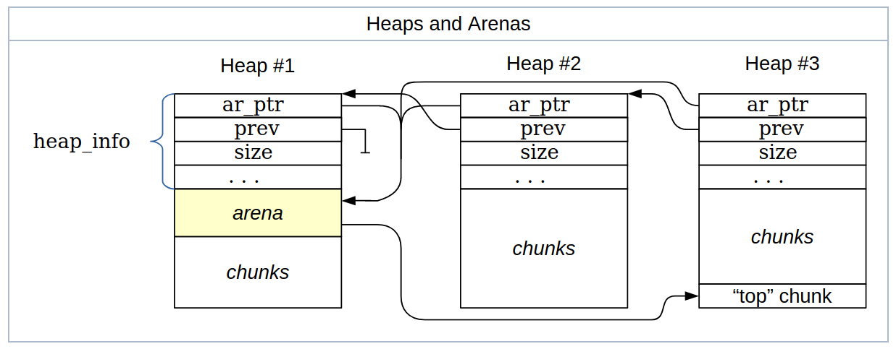
Threading Complications
"The Heap" isn't as uniform a concept as you might think. ptmalloc has "arenas", which are homes for chunks.
Each thread makes at least one new arena to allocate from.
Take-away 1: the leaks will be pointers to the thread's arena
Take-away 2: early chunks in threads will have NULLs in the address

Slide 6
Knowledge Check
Current state:
PIE base (binary address)
ASLR base (library addresses)
Stack base
Heap base (main arena)
Thread-specific arenas
Canary

Slide 7
Leaking the Arena Address
Two routes:
Make enough allocations to make a non-null address.
Moar race conditions!
Consider printf("%s", messages[idx]);
How would you write that? Maybe:
int printf_string(the_string) {
int length = strlen(the_string);
write(1, the_string, length);
}
Notice something missing? No locking!

Slide 8
Leaking the Arena Address
Race condition to get:
// using the "malloc" action
a = malloc(1024);
// using the "scanf" action
scanf("%1024s", a);
// in printf
int length = strlen(a);
write(1, a, length);
No-nonsense leak!
// using the "free" action
free(a);

Slide 9
Knowledge Check
Current state:
PIE base (binary address)
ASLR base (library addresses)
Stack base
Heap base (main arena)
Thread-specific arenas
Canary

