Slide 1
Automated Vulnerability Discovery
Introduction
Yan Shoshitaishvili Arizona State University

Slide 2


Slide 3

Embedded device 0day

Slide 4
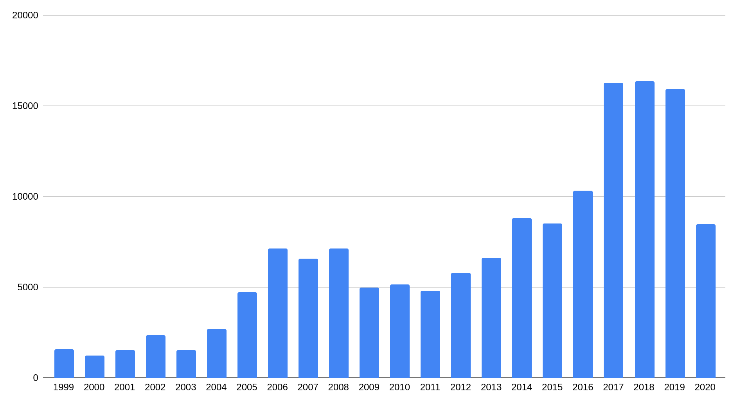
We're not keeping up...
# CVEs
Year

Slide 5
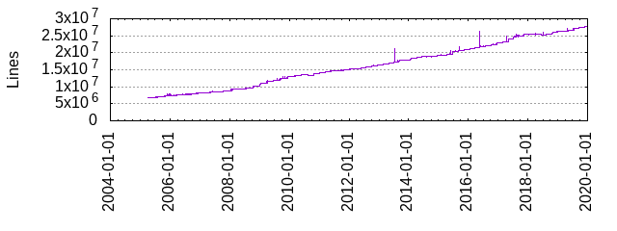
We're not keeping up...
# CVEs
Year

Slide 6
We're not keeping up...
67M GitHub Repos
131M GitHub Repos
# CVEs
Year

Slide 7

Alan Turing.
"Checking a large routine."
EDSAC Inaugural Conference, 1949.

Slide 8
Alan Turing.
"Checking a large routine."
EDSAC Inaugural Conference, 1949.
Is the program correct secure?

Slide 9
Analysis Paradigms
Static techniques try to find flaws without executing the program.
Dynamic techniques execute the program to find flaws.

Slide 10
Static Analysis
Pros:
Don't need to execute the program!
Can make guarantees of spotting all instances of specific vulnerability classes.
Cons:
Typically require source code.
Incredible imprecise.
"There is a buffer overflow on every line of the program" will technically spot all instances of buffer overflows...

Slide 11
Dynamic Analysis
Pros:
Typically don't require source code.
Very precise.
Cons:
Must run the program to analyze it. Not trivial for:
complex programs
libraries
embedded devices
Can only spot bugs if the bug is triggered.
"No bugs detected" is a quite normal result of dynamic analysis of buggy programs.

Slide 12
"The uses of symbolic execution, concolic execution, static analysis, and other emerging technologies to spot substantial vulnerabilities in complex, unstructured, and non-annotated code are still in their infancy."
Michael Zalewski, 2015

