Slide 1
Automated Vulnerability Discovery
Static Analysis
Yan Shoshitaishvili
Arizona State University

Slide 2
Static Analysis
Pros:
Don't need to execute the program!
Can make guarantees of spotting all instances of specific vulnerability classes.
Cons:
Typically require source code.
Incredible imprecise.
"There is a buffer overflow on every line of the program" will
technically spot all instances of buffer overflows...

Slide 3
The Basics: objdump, grep, sed, and friends
You have already done static analysis!
Manual static analysis: Ghidra, Binary Ninja, IDA, objdump, grep, sed, etc...
Automated static analysis: Ghidra, Binary Ninja, IDA, objdump, grep, sed, angr, etc...
Your manual actions can often be automated.

Slide 4
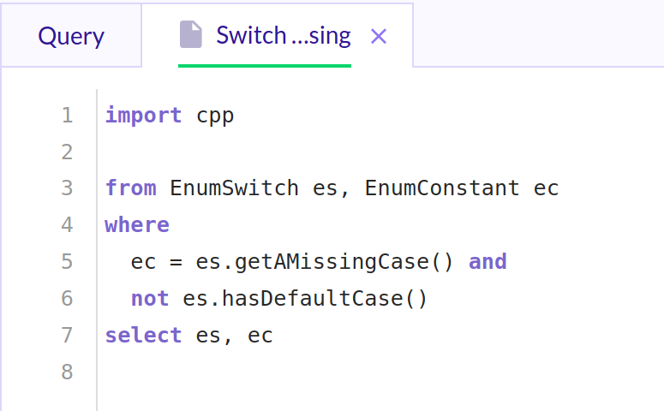
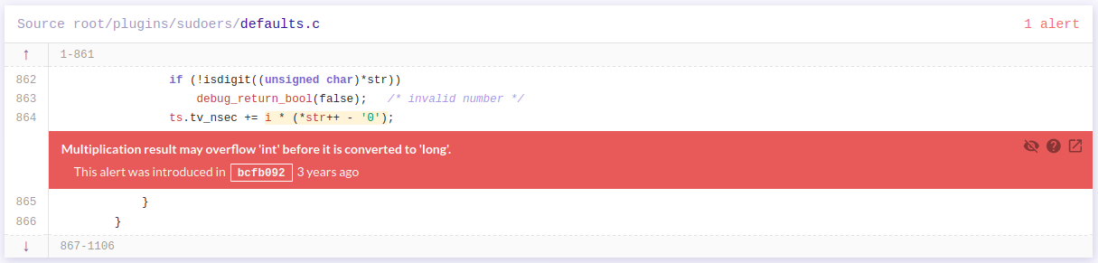
Advanced Static Analysis: CodeQL
CodeQL is a turnkey way to perform security queries on large codebases.
Queries can be written, but there are many canned queries included!
Example, sudo: https://lgtm.com/projects/g/sudo-project/sudo?mode=list

Slide 5
Static Analysis Tools
angr is a python library providing many different binary analysis capabilities.
IDA, Ghidra, and Binary Ninja (non-cloud) are all scriptable!
Clang and GCC!

