Slide 1
Automated Vulnerability Discovery
Fuzzing
Yan Shoshitaishvili Arizona State University

Slide 2
Dynamic Analysis
Pros:
Typically don't require source code.
Very precise.
Cons:
Must run the program to analyze it. Not trivial for:
complex programs
libraries
embedded devices
Can only spot bugs if the bug is triggered.
"No bugs detected" is a quite normal result of dynamic analysis of buggy programs.

Slide 3
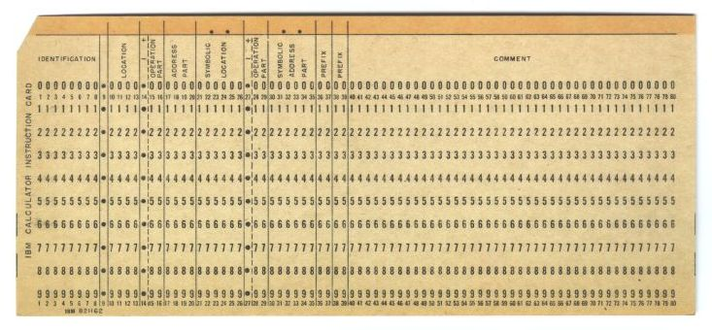
Origins: Program testing via "Trash Decks"
1950s
http://secretsofconsulting.blogspot.com/2017/02/fuzz-testing-and-fuzz-history.html

Slide 4
Fuzzing: Scientific Framing
Joe W. Duran, et al.
"A report on random testing".
ACM SIGSOFT International Conference on Software Engineering, 1981.
1981
Notes:
1968: description of pointer sanitization in "Protection in an information processing utility. RM Graham"
1972: description of actual attack in "Computer Security Technology Planning Study"

Slide 5
Original Idea
Core concept: programmers assume that users are well-behaved.
Run the program.
Send it random data as input.
See if it crashes.
# while true > do > cat /dev/urandom | monitor_for_crashes.py /babymem_level1_testing1 > done
That's ... surprisingly effective.

Slide 6
monitor_for_crashes.py
Fuzzers tend to find crashes. Crashes are easy to detect!
Other types of vulnerabilities are harder, but doable:
Race Conditions
Algorithmic Attacks
Information Disclosures
Lots of active research on this!

Slide 7
Generational Fuzzing
Generational fuzzers use intelligent techniques to generate program inputs!
# while true > do > generate_elf_file.py /tmp/random-elf > monitor_for_crashes.py objdump -d /tmp/random-elf > done
Example:
Peach Fuzzer (https://www.peach.tech/)

Slide 8
Mutational Fuzzing
Mutational fuzzers mutate existing inputs to try to trigger new program behavior (and bugs!).
# while true > do > mutate_input.py /tmp/random-elf1 > /tmp/random-elf2 > monitor_for_crashes.py objdump -d /tmp/random-elf2 > done
Core questions:
How to select inputs to mutate?
How to mutate inputs?

Slide 9
Coverage-guided Mutational Fuzzing
Modern fuzzers have the following loop:
Start with a provided seed corpus as pending inputs.
Analysis Loop
Execute target program with every pending input.
Record what instructions were executed when processing each pending input.
Mark inputs that increase code coverage as interesting inputs.
Mutate interesting inputs to produce a new set of pending inputs.
Find bugs!
Some questions:
Seed corpus?
How do we identify an increase in code coverage?
How do we mutate inputs?

Slide 10
"The uses of symbolic execution, concolic execution, static analysis, and other emerging technologies to spot substantial vulnerabilities in complex, unstructured, and non-annotated code are still in their infancy."
Michael Zalewski, 2015
Creator, American Fuzzy Lop

Slide 11
Seed Corpus
The seed corpus is critical.
The infinite monkey theorem states that a monkey hitting keys at random on a typewriter keyboard for an infinite amount of time will almost surely type any given text, such as the complete works of William Shakespeare. [https://en.wikipedia.org/wiki/Infinite_monkey_theorem]
... but this will take a VERY LONG TIME.
Your seed corpus helps the monkeys. Make it:
Varied: it should represent a good coverage of the functionality of the program
Weird: it should trigger enough uncommon behavior to give the fuzzer a good starting point to trigger really rare behavior. Also have some normal stuff!
Small: AFL will eventually try to mutate every bit. Don't put in useless bits.

Slide 12
Measuring Code Coverage
Many coverage tracking techniques exist:
track each instruction that was executed
track each basic block that was executed
track each function that was executed
American Fuzzy Lop insight: It's not the code that matters, it's how you traverse it!
AFL measures control flow transitions, pairs of basic blocks connected by a jump.

Slide 13
Mutating Inputs
AFL ships with several mutators:
bitflip L/S: L bits toggled at a time, walking the input file with S-bit increments. Currently: 1/1, 2/1, 4/1, 8/8, 16/8, 32/8.
arith L/8: subtract or add small integers to 8, 16, and 32-bit values. The stepover is 8 bits.
interest L/8: list of known “interesting” 8, 16, and 32-bit values to try. The stepover is 8 bits.
extras: deterministic injection (or replacement) of user-supplied or automatically determined dictionary terms.
havoc: random tweaks. Operations attempted bit flips, overwrites with random and “interesting” integers, block deletion, block duplication, assorted dictionary-related operations.
splice: splices together two random inputs from the queue at some arbitrarily selected midpoint.
Source: https://afl-1.readthedocs.io/en/latest/user_guide.html

Slide 14
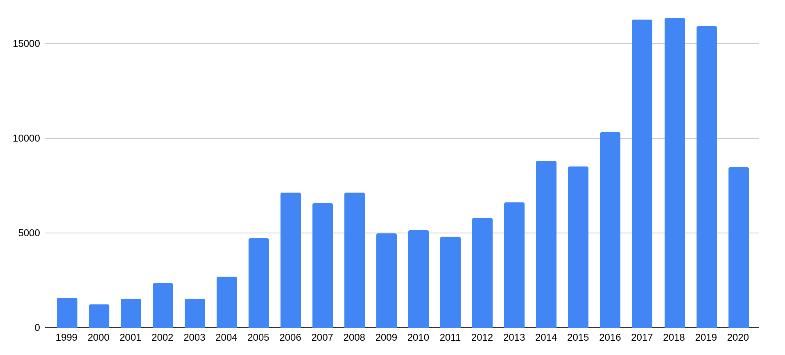
Fuzzing is King
Fuzzing is undeniably the best automated program analysis technique we have.
Fuzzing finds thousands of bugs every year.
AFL Released

Slide 15
Cutting-Edge Fuzzers
Too many fuzzers to keep track of! Notable mentions:
OSS-Fuzz: continuous fuzzing for open-source software (https://github.com/google/oss-fuzz)
syzkaller: system call fuzzing for Linux (https://github.com/google/syzkaller)
libfuzzer: fuzzing library integrated into Clang/LLVM (https://llvm.org/docs/LibFuzzer.html)
afl++: community-maintained AFL fork (https://github.com/AFLplusplus/AFLplusplus)
Further reading: https://github.com/secfigo/Awesome-Fuzzing

