Slide 1
Automated Vulnerability Discovery
Dynamic Symbolic Execution
Yan Shoshitaishvili Arizona State University

Slide 2
Dynamic Analysis
Pros:
Typically don't require source code.
Very precise.
Cons:
Must run the program to analyze it. Not trivial for:
complex programs
libraries
embedded devices
Can only spot bugs if the bug is triggered.
"No bugs detected" is a quite normal result of dynamic analysis of buggy programs.

Slide 3
Symbolic Execution: Core Idea
Emulate the program, keeping unknown data symbolic.
Generate formulas representing relationships between program input, program conditions, and program output. (user_input == 42 AND program_output == the_flag) OR (user_input != 42 AND program_output == "INCORRECT")
Add desired constraints and query a constraint solver to solve the formulas! ( (user_input == 42 AND program_output == the_flag) OR (user_input != 42 AND program_output == "INCORRECT") ) AND (program_output != "INCORRECT")
mov rax, 0 mov rdi, 0 mov rdx, 1 syscall cmp qword ptr [rsi], 42 je .get_flag
rax = 0 rax = 0, rdi = 0 rax = 0, rdi = 0, rdx = 1 rax = 0, rdi = 0, rdx = 1, [rsi] = user_input rax = 0, rdi = 0, rdx = 1, [rsi] = user_input, user_input == 42?
user_input == 42

Slide 4
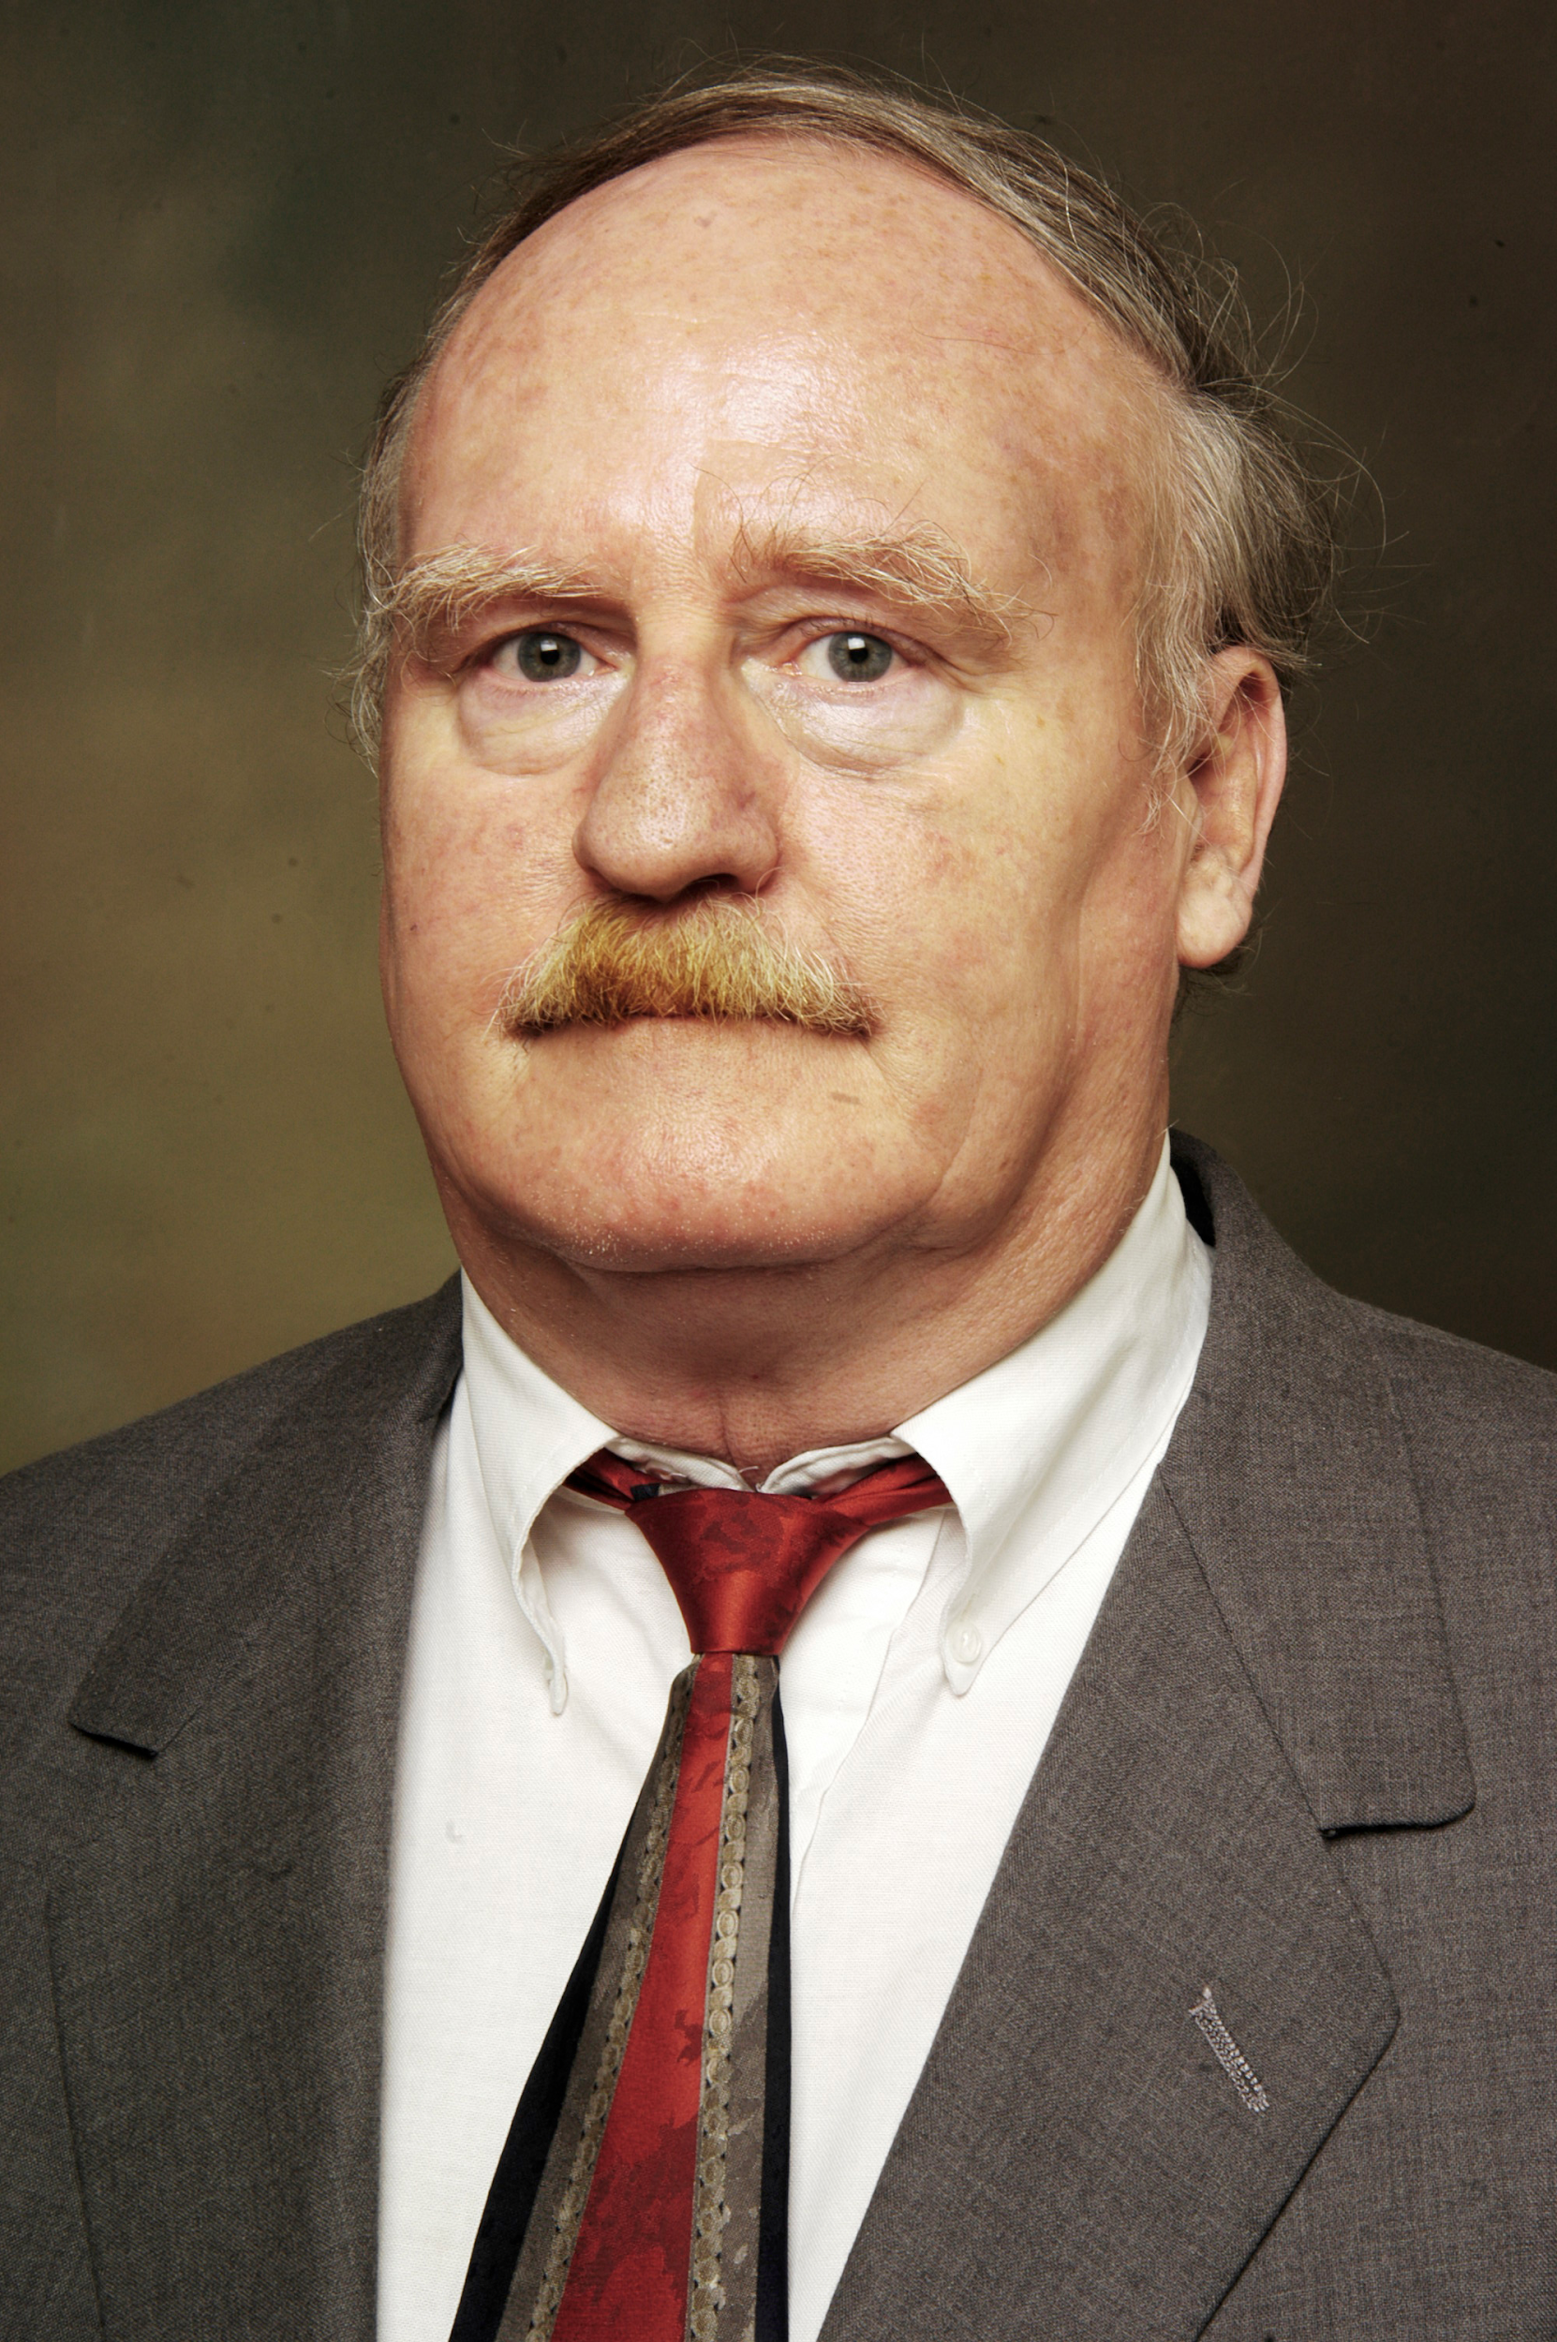
The Rise of Symbolic Execution
Robert Boyer, et al.
"SELECT—a formal system for testing and debugging programs by symbolic execution."
ACM SigPlan Notices, 1975.
1975
Notes:
1968: description of pointer sanitization in "Protection in an information processing utility. RM Graham"
1972: description of actual attack in "Computer Security Technology Planning Study"

Slide 5
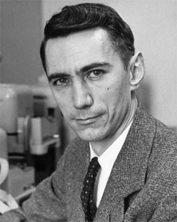
Earlier?
Claude Shannon.
"A Symbolic Analysis of Relay and Switching Circuits."
Electrical Engineering, 1938.
1938

Slide 6
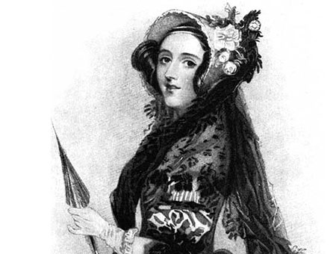
1842

Slide 7
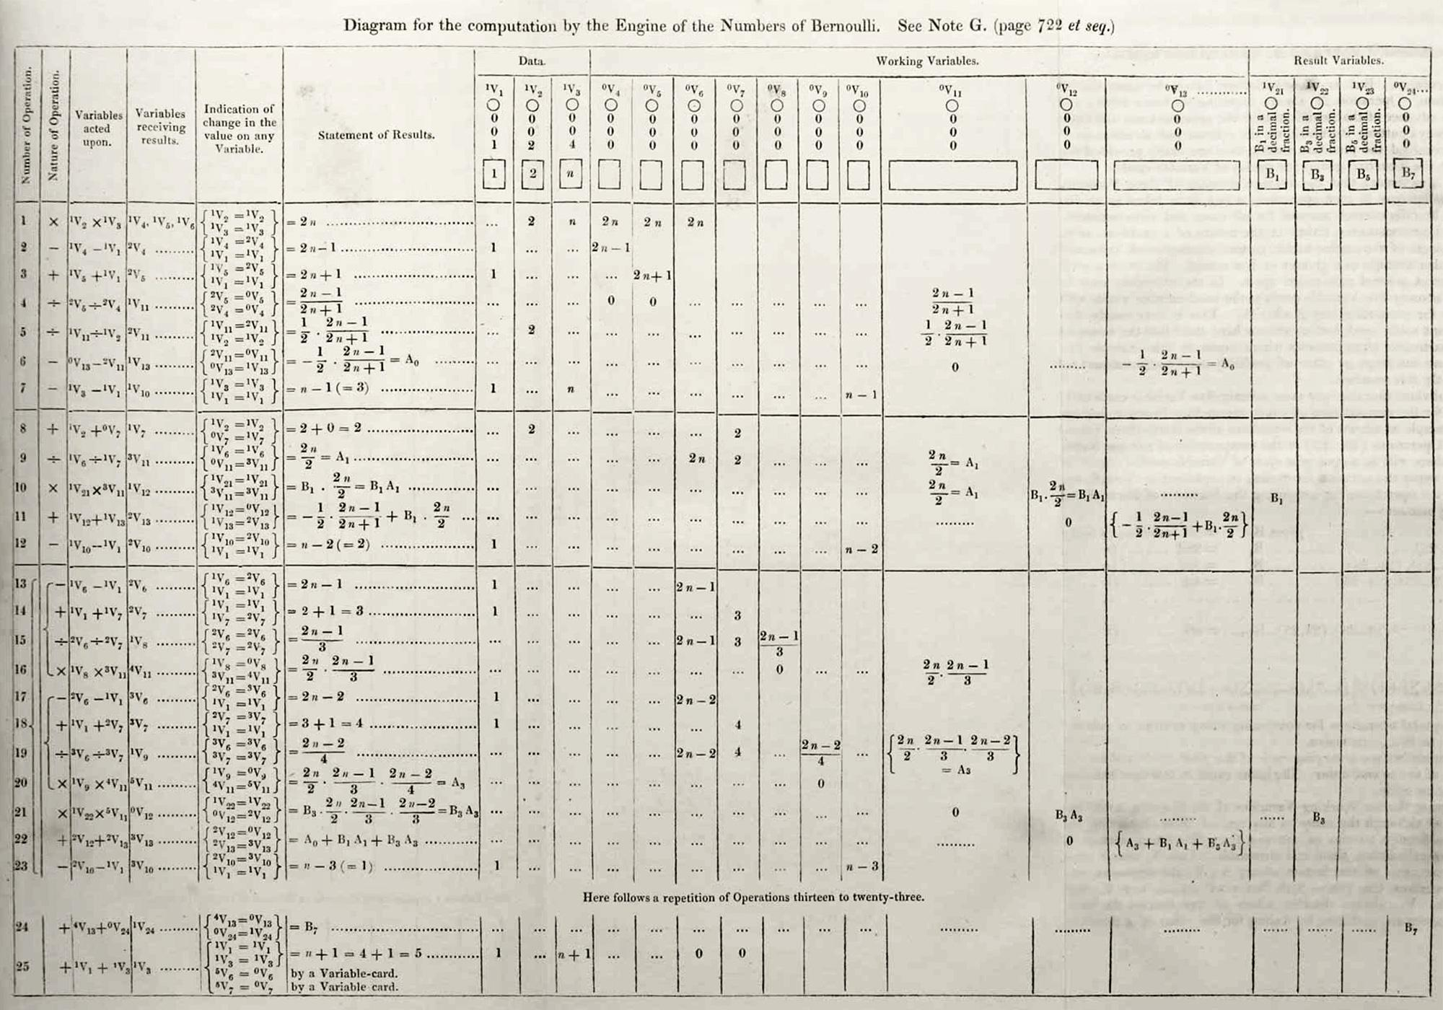
1842

Slide 8
Symbolic Execution in Practice
mov rax, 0 mov rdi, 0 mov rdx, 1 syscall cmp qword ptr [rsi], 42 je .get_flag
Translating to "math" isn't that easy...
Symbolic execution works by emulating code.
This means it has to follow a path...
.get_flag: mov rax, 2 mov rdi, "flag" mov rsi, 0 syscall mov rsi, rax mov rax, 40 mov rdi, 1 mov rdx, 0 mov r10, 100 syscall
mov rax, 1 mov rdi, 1 mov rsi, "INCORRECT!\n" mov rdx, 11 syscall

Slide 9
Symbolic Execution in Practice
mov rax, 0 mov rdi, 0 mov rdx, 1 syscall cmp qword ptr [rsi], 42 je .get_flag
Translating to "math" isn't that easy...
Symbolic execution works by emulating code.
This means it has to follow a path... ... or multiple paths.
The symbolic execution engine tracks an additional state for every branch in the program!
.get_flag: mov rax, 2 mov rdi, "flag" mov rsi, 0 syscall mov rsi, rax mov rax, 40 mov rdi, 1 mov rdx, 0 mov r10, 100 syscall
mov rax, 1 mov rdi, 1 mov rsi, "INCORRECT!\n" mov rdx, 11 syscall
STATE A: rax == 40 rdx == 0 rdi == 1 rsi == 3 r10 == 100 user_input == 42 program_output == the_flag
STATE B: rax == 1 rdx == 11 rdi == 1 rsi == "INCORRECT\n" r10 == ??? user_input != 42 program_output == "INCORRECT!\n"

Slide 10
Symbolic Execution Tools
Symbolic Execution is a popular area of research, with much tooling available!
angr: our binary analysis framework that does (among other things) symbolic execution.
miasm: another binary analysis framework that does symbolic execution.
s2e: another binary analysis framework that does symbolic execution.
manticore: another binary analysis framework that does symbolic execution.
klee: symbolic execution on source code.

Slide 11
Symbolic Execution Limits
Symbolic execution operates on the path level. Consider the difference between:
mov rax, 0 mov rdi, 0 mov rdx, 1 syscall cmp qword ptr [rsi], 42 je .get_flag
And:
mov rax, 0 mov rdi, 0 mov rdx, 2 syscall mov rdi, rsi call atoi cmp qword ptr rax, 42 je .get_flag

Slide 12

unsigned long atoi(char *s) {
unsigned long n = 0;
while (*s != 0) {
if (*s == '0') n = n*10;
else if (*s == '1') n = n*10 + 1;
else if (*s == '2') n = n*10 + 2;
else if (*s == '3') n = n*10 + 3;
else if (*s == '4') n = n*10 + 4;
else if (*s == '5') n = n*10 + 5;
else if (*s == '6') n = n*10 + 6;
else if (*s == '7') n = n*10 + 7;
else if (*s == '8') n = n*10 + 8;
else if (*s == '9') n = n*10 + 9;
else break;
s++;
}
return n;
}
s = ???
s = 0??
s = 1??
s = 2??
...
s = \n
s = 0
s = 1
s = 2
s = 00?
s = 10?
s = 20?
...
s = 01?
s = 11?
s = 21?
s = 02?
s = 12?
s = 22?

Slide 13
Limitation: Path Explosion
Path explosion is the #1 bane of symbolic execution engines.
Active area of research, but very much unsolved.

Slide 14
Limitation: Constraint Solving
Solving for user_input == 42 is easy, but constraints can get arbitrarily complex...
Constraints are solved by SMT Solvers (Satisfiability Modulo Theories). Process:
Try a bunch of math simplifications (a*b == b*a).
Check against common cases.
Synthesize a circuit representing the bits involved and resort to SAT Solving (Boolean SATisfiability).
SAT is NP Complete (https://en.wikipedia.org/wiki/Boolean_satisfiability_problem).
Take-away: when faced with complex data relationships and constraints, symbolic execution engines fail.

Slide 15
Limitation: Environment Modeling
Symbolic execution engines are emulators. This has two parts:
Emulating the CPU: this is actually not conceptually difficult.
Emulating the OS: this is incredibly hard.
Emulating read() is easy. How about load_module()?

Slide 16
"The uses of symbolic execution, concolic execution, static analysis, and other emerging technologies to spot substantial vulnerabilities in complex, unstructured, and non-annotated code are still in their infancy."
Michael Zalewski, 2015
Creator, American Fuzzy Lop

