Slide 1
Automated Vulnerability Discovery
The Cyber Grand Challenge
Yan Shoshitaishvili
Arizona State University

Slide 2


Slide 3
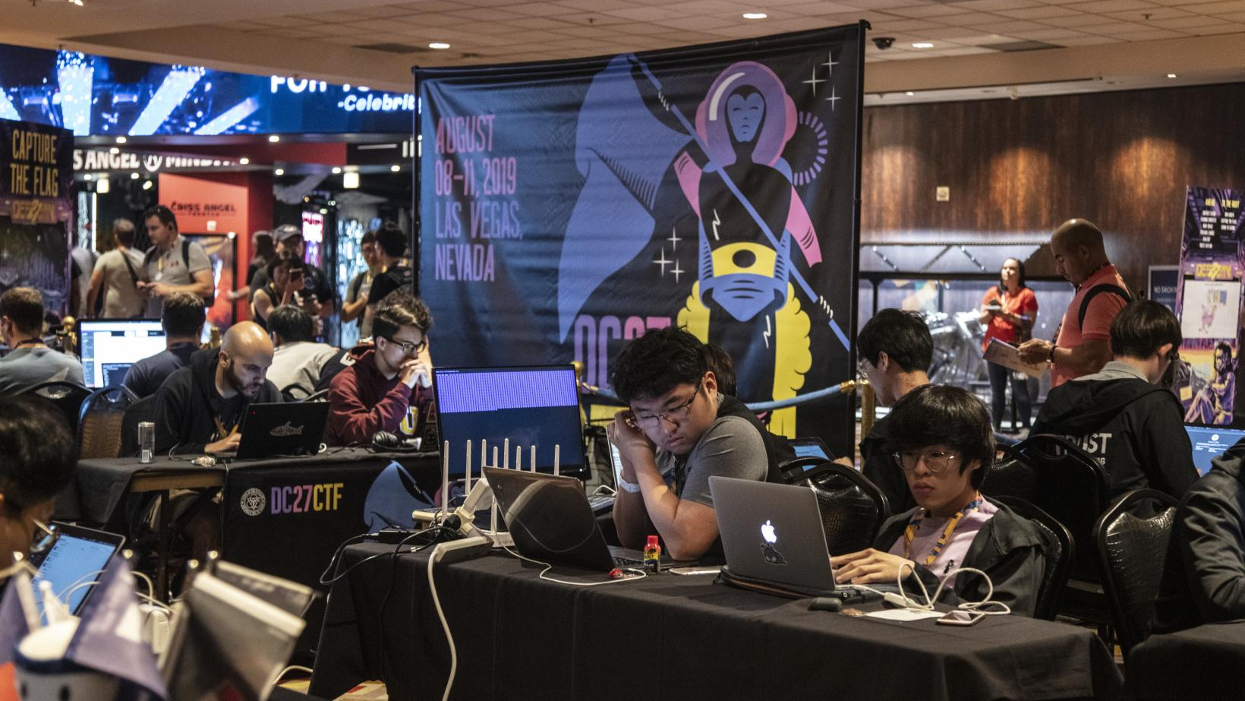

Slide 4


Slide 5


=

Slide 6

=

Slide 7
>

Slide 9
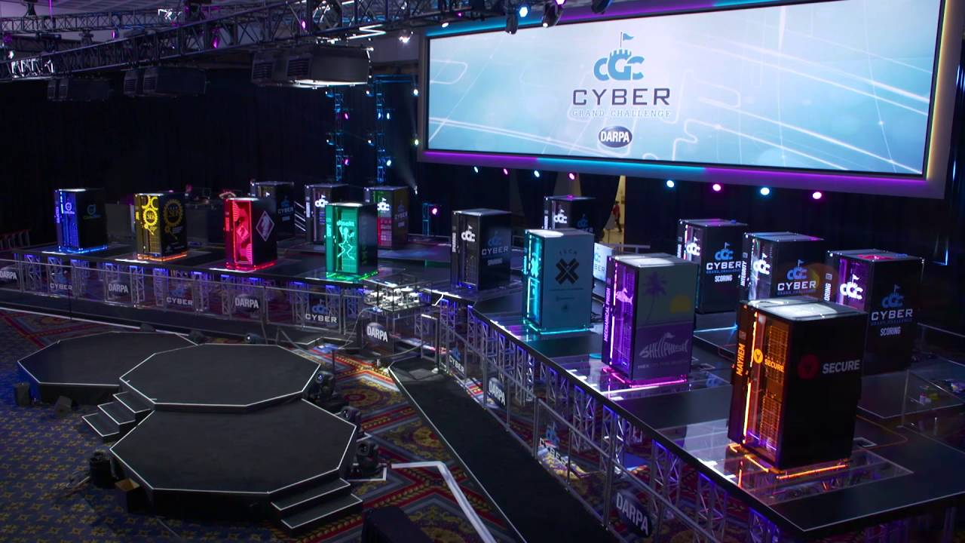

Slide 10
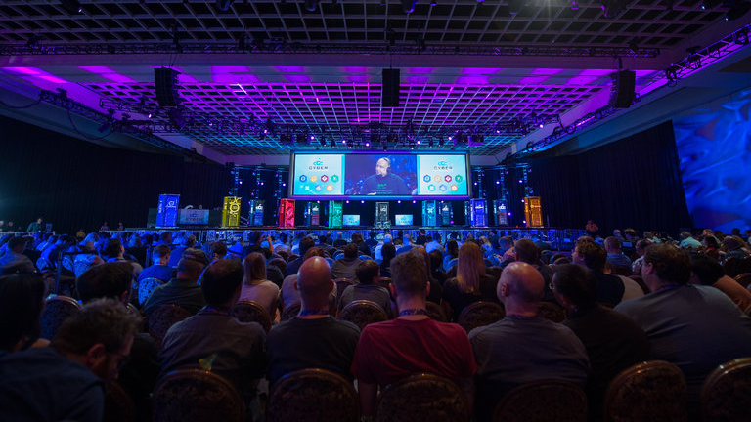

Slide 11
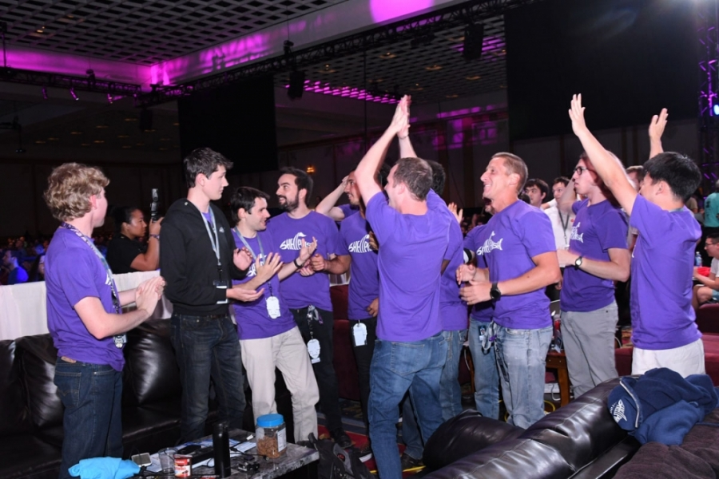

Slide 12
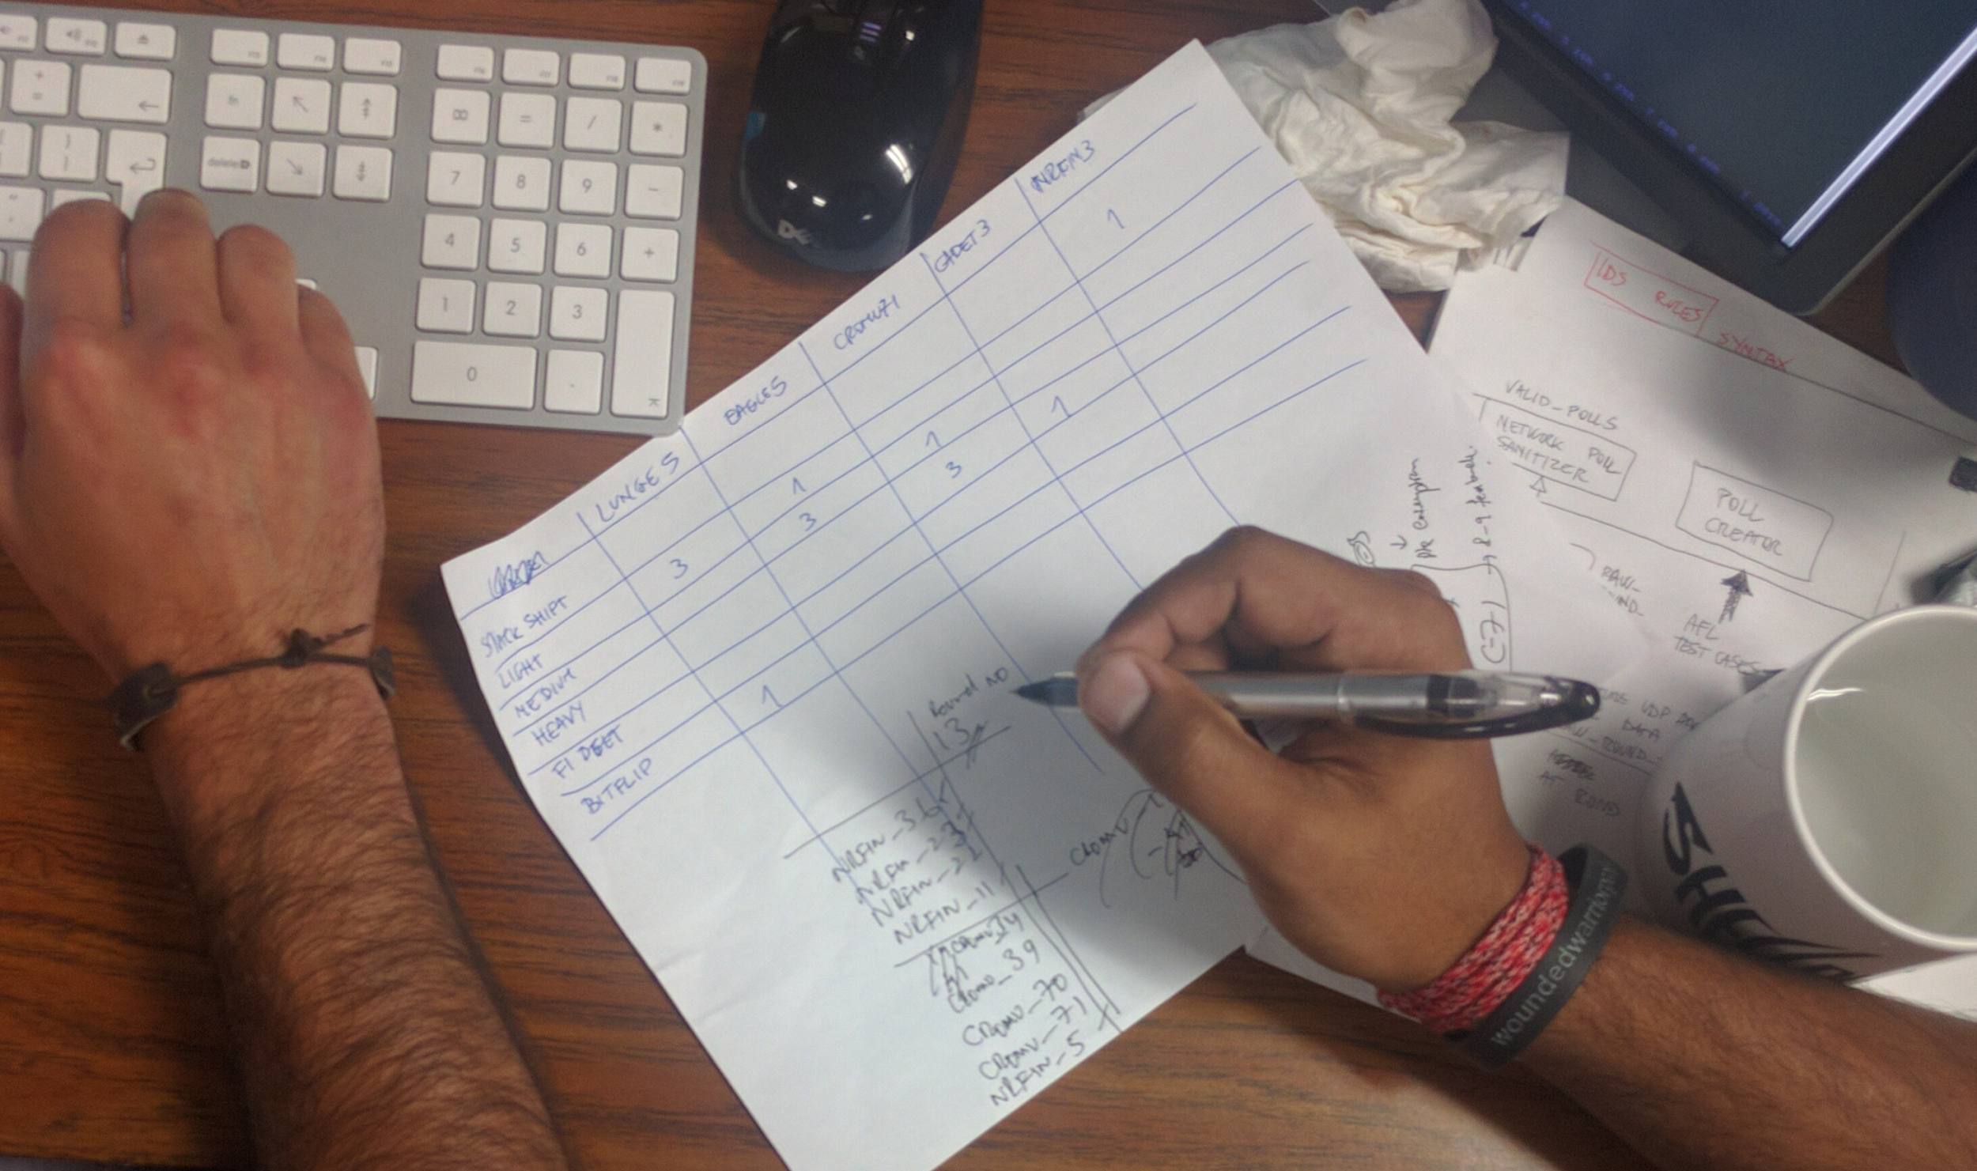

Slide 13
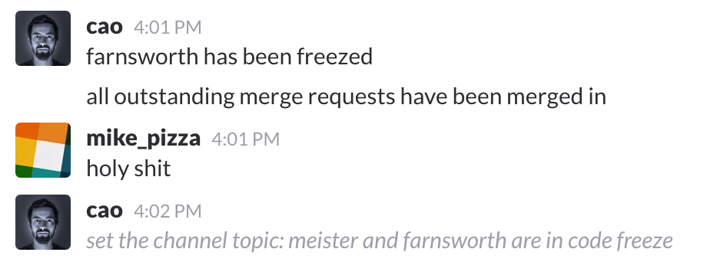
Code Freeze?

Slide 14
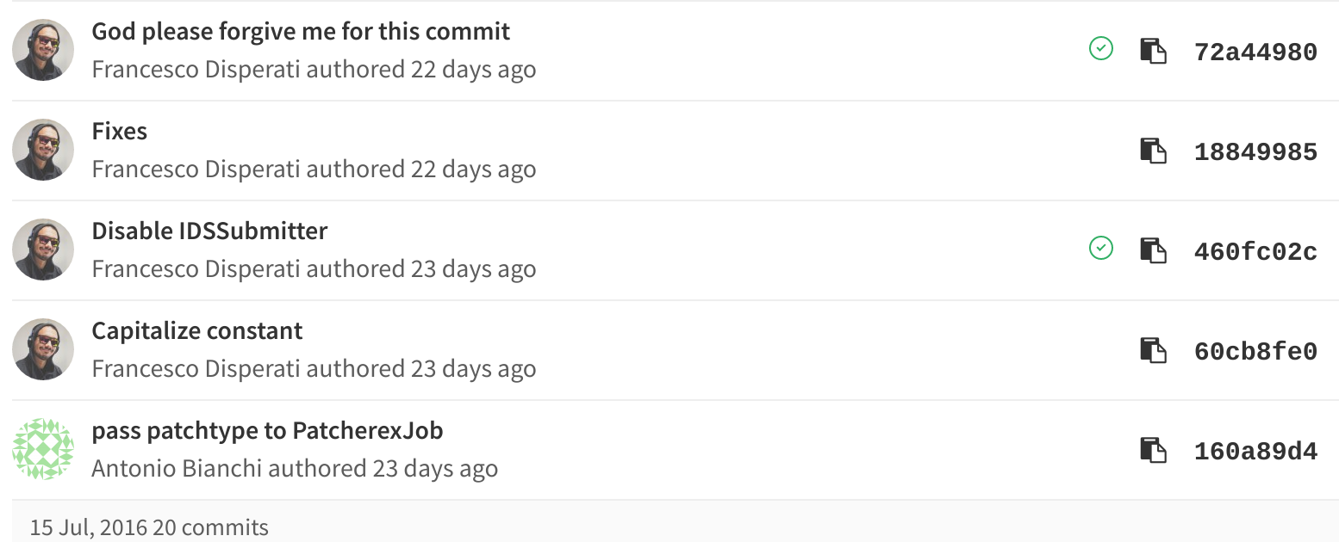

Slide 15
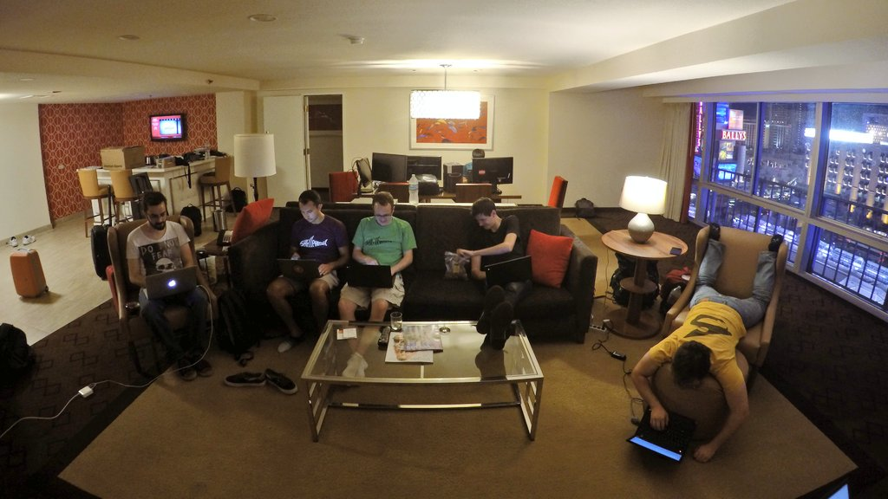
Tue 2 Aug, 23:54
~15 hours before access shutdown
Full video: https://youtu.be/xjojOt4q4Yo

Slide 16
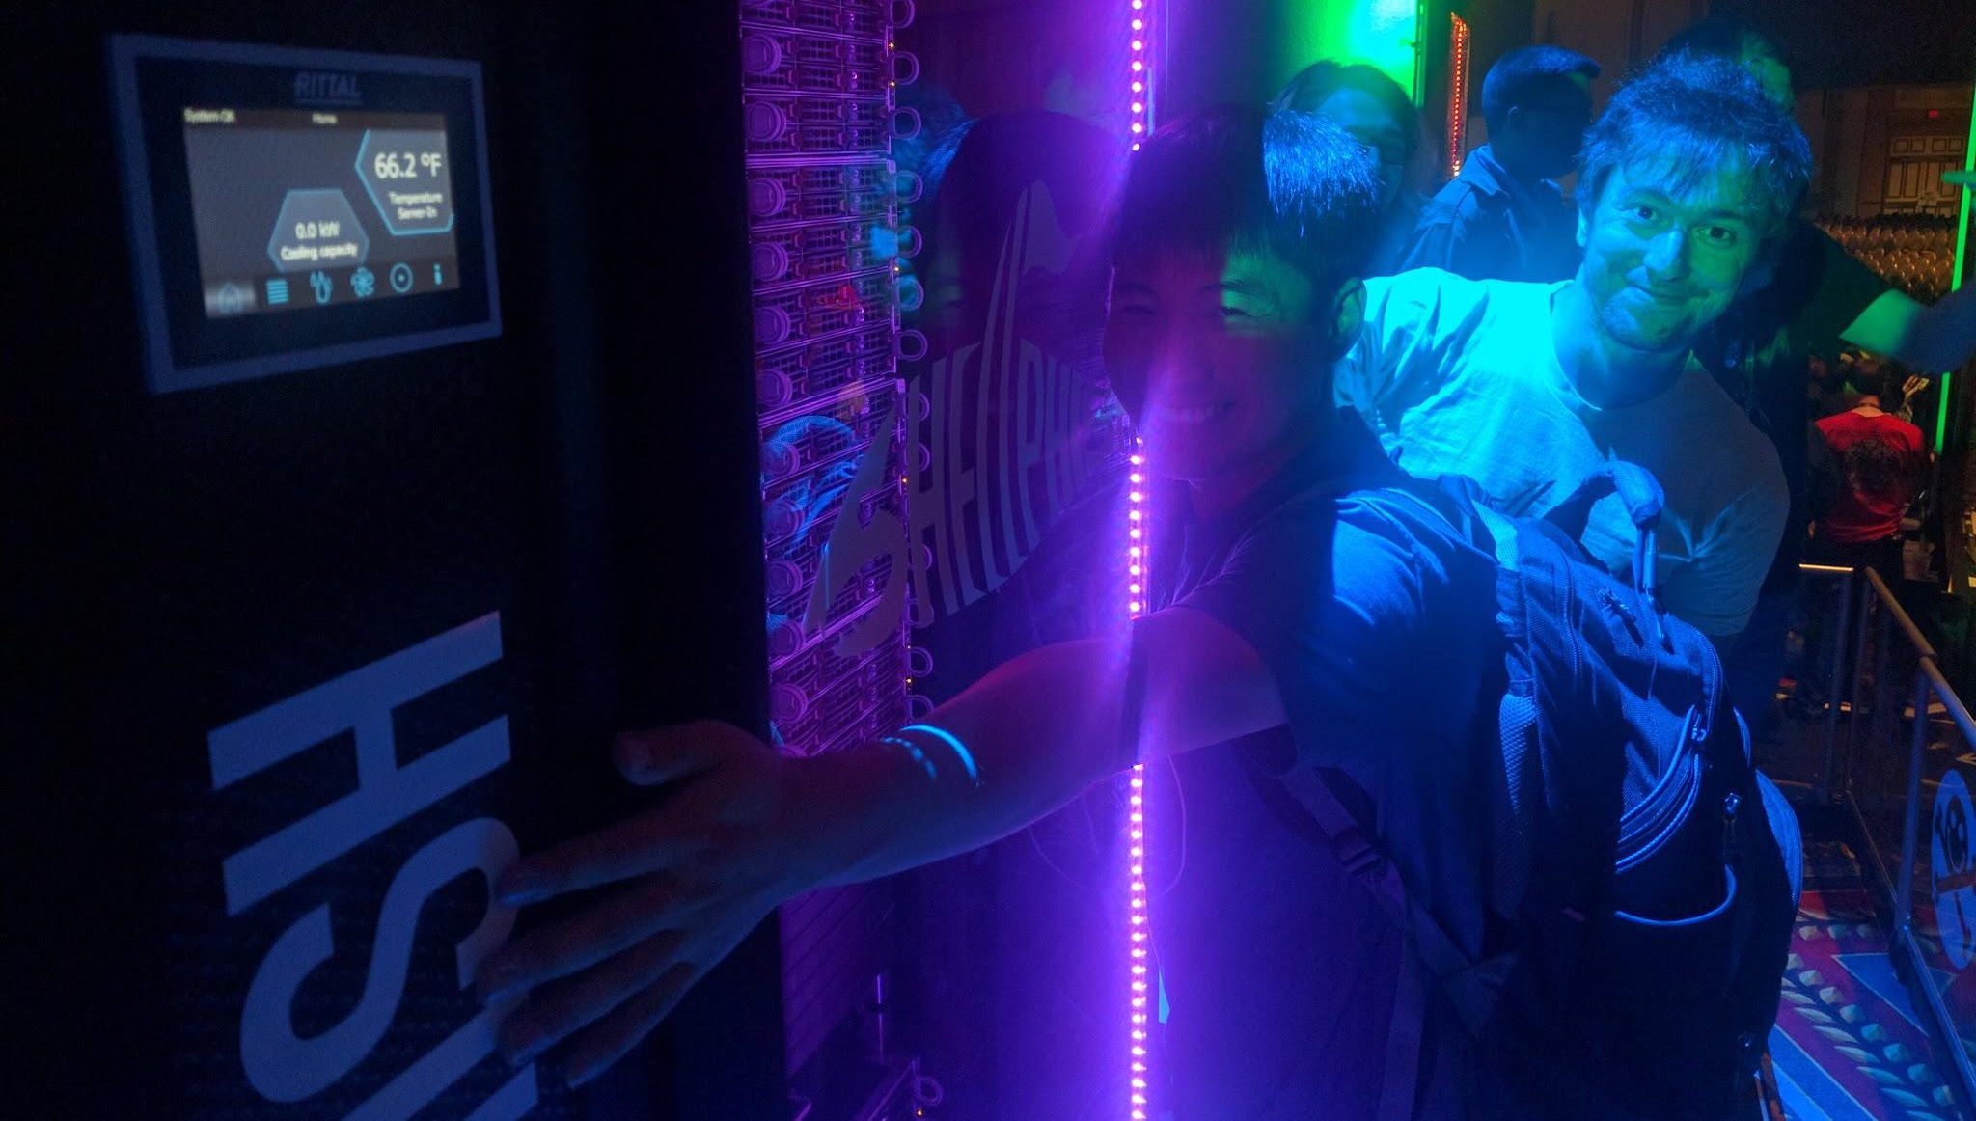

Slide 17
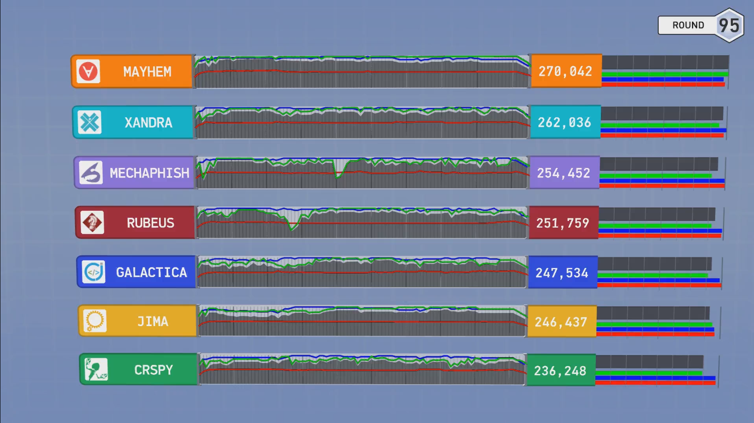

Slide 19


2016, at the Cyber Grand Challenge Final Event
Automatic analysis
simplified DECREE Operating System
7 system calls (equivalents of read, write, select, mmap, munmap, get_random, exit)
no persistence, threading, network, etc
Automatic exploitation
opportunistic instruction pointer overwrites
ROP chain generation
Automatic repair
general program hardening through binary rewriting
Artificial intelligence?
lol

